Slide 1

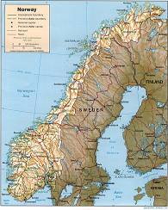
Diagnostic challenges in simple and complex endodontic infections
Bacteriology, pathogenesis, clinical manifestations, therapeutic intervention

Slide 2
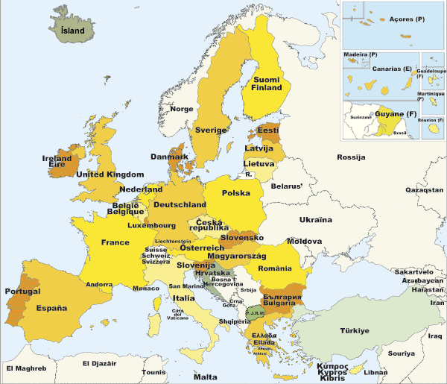

Slide 3
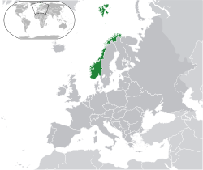


Area 385,252 km²
Population 4,907,000
Kingdom since 874 AD
Modern constitution 1814 AD
Independent – not member of EU

Slide 4
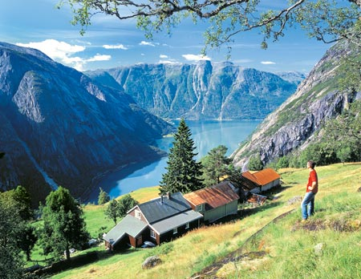

Slide 5
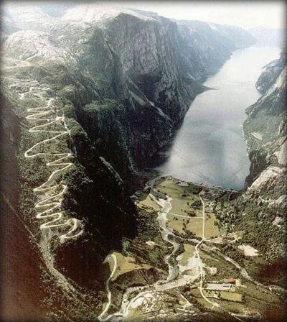

Slide 6
Basic theme for this lecture
Guessing-assessing: where and which are the bacteria?
Not so much how, but why and when to treat and by which method
P

Slide 7
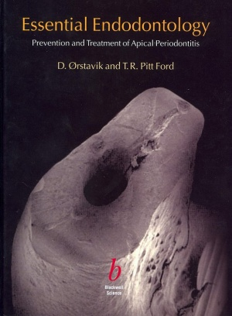
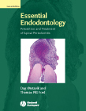
Endodontics is:
Prevention or treatment of apical periodontitis
which in practice means
Protection against or elimination of root canal infection
Ørstavik 1988

Slide 8
Simple endodontic infections
Caries
Crown fracture of limited extent
Pulpitis
  reversible
  Irreversible
Pulpal infection
Pulpal necrosis
Primary apical periodontitis

Slide 9
Complex endodontic infections
Partial pulpal infection
Endo-perio situations
Secondary apical periodontitis
Persistent apical periodontitis
Root resorptions
  Traumatic, infectious
    Inflammatory and replacement resorption
  Internal resorptions
  Cervical resorptions
Medical conditions of consequence

Slide 10
Simple endodontic infections
Caries
Crown fracture of limited extent
Pulpitis
  Reversible
  Irreversible
Pulpal infection
Pulpal necrosis
Primary apical periodontitis

Slide 11
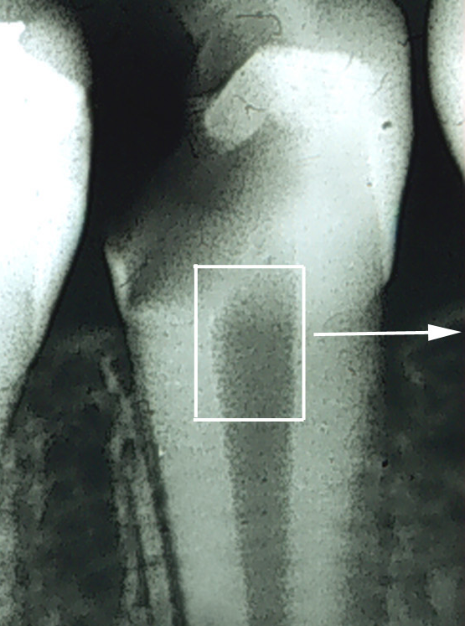
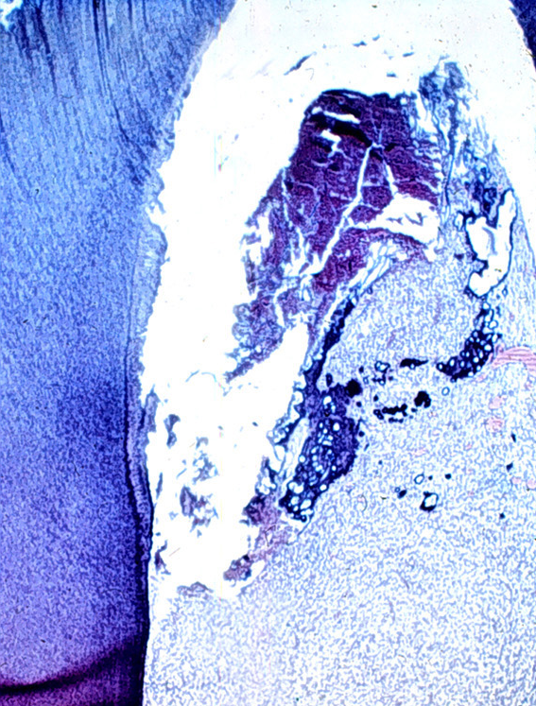
Simple endodontic infections
Caries
Crown fracture of limited extent
Pulpitis
  Reversible
  Irreversible
Pulpal infection
Pulpal necrosis
Primary apical periodontitis
Illustrations from Spångberg & Haapasalo, Endodontic Topics 2002

Slide 12
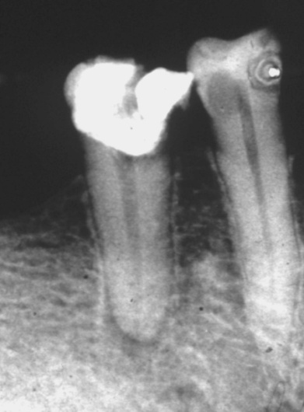
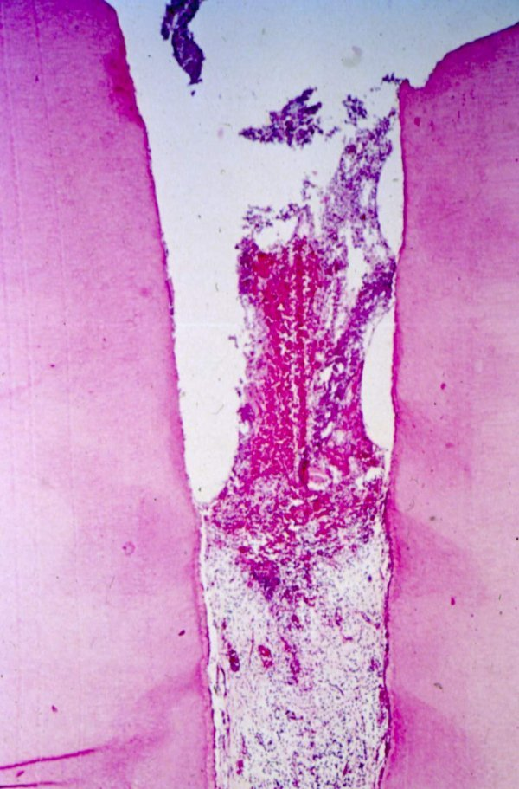
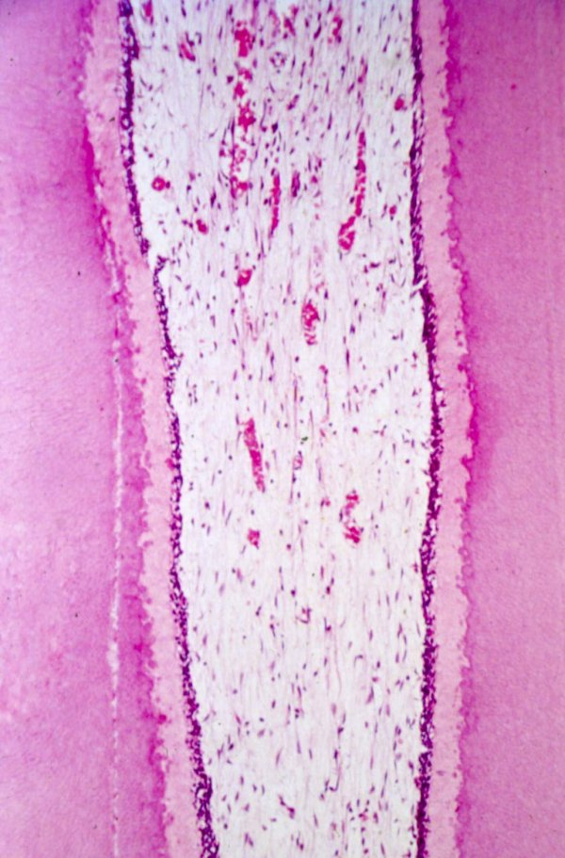
Simple endodontic infections
Caries
Crown fracture of limited extent
Pulpitis
  reversible
  Irreversible
Pulpal infection:
Miller 1890
Langeland 1980
Pulpal necrosis
Primary apical periodontitis

Slide 13

Simple endodontic infections
Caries
Crown fracture of limited extent
Pulpitis
  reversible
  Irreversible
Pulpal infection
Pulpal necrosis
  Bluetooth® technology is a cutting-edge open specification that enables short-range wireless connections
  Harold Bluetooth, king of Denmark and Norway 960 AD
Primary apical periodontitis

Slide 14
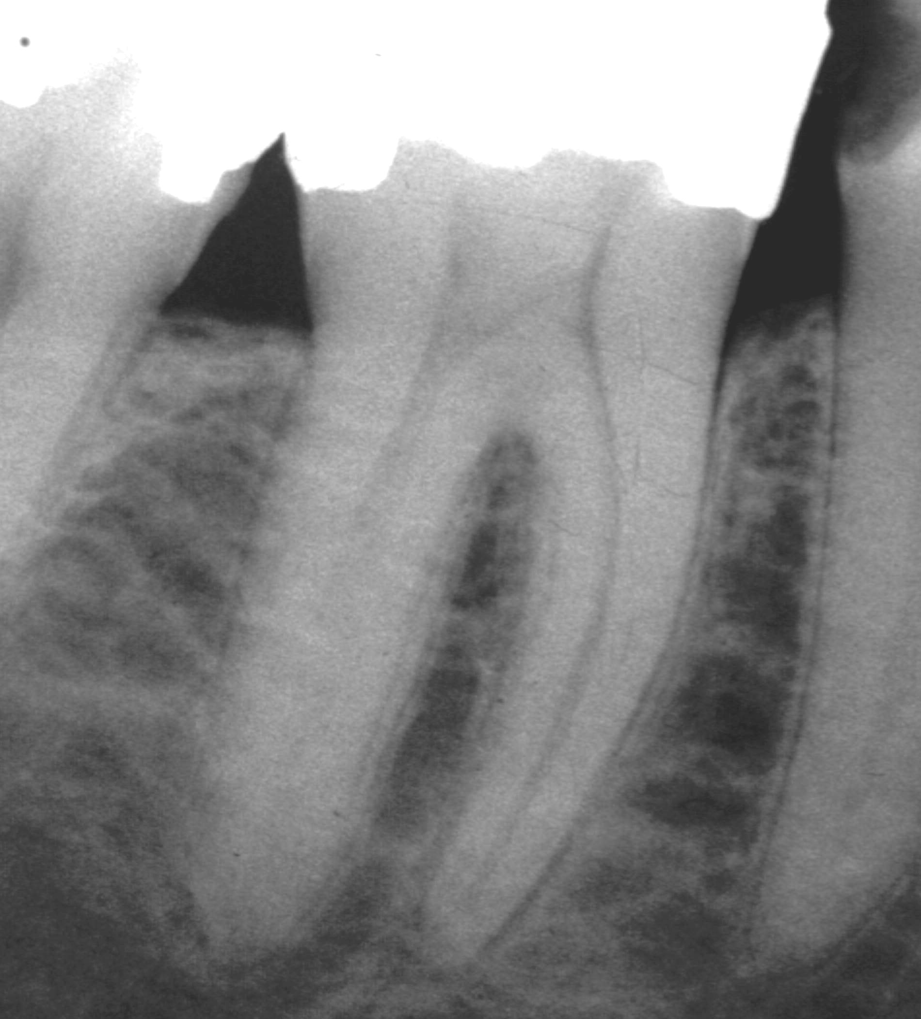
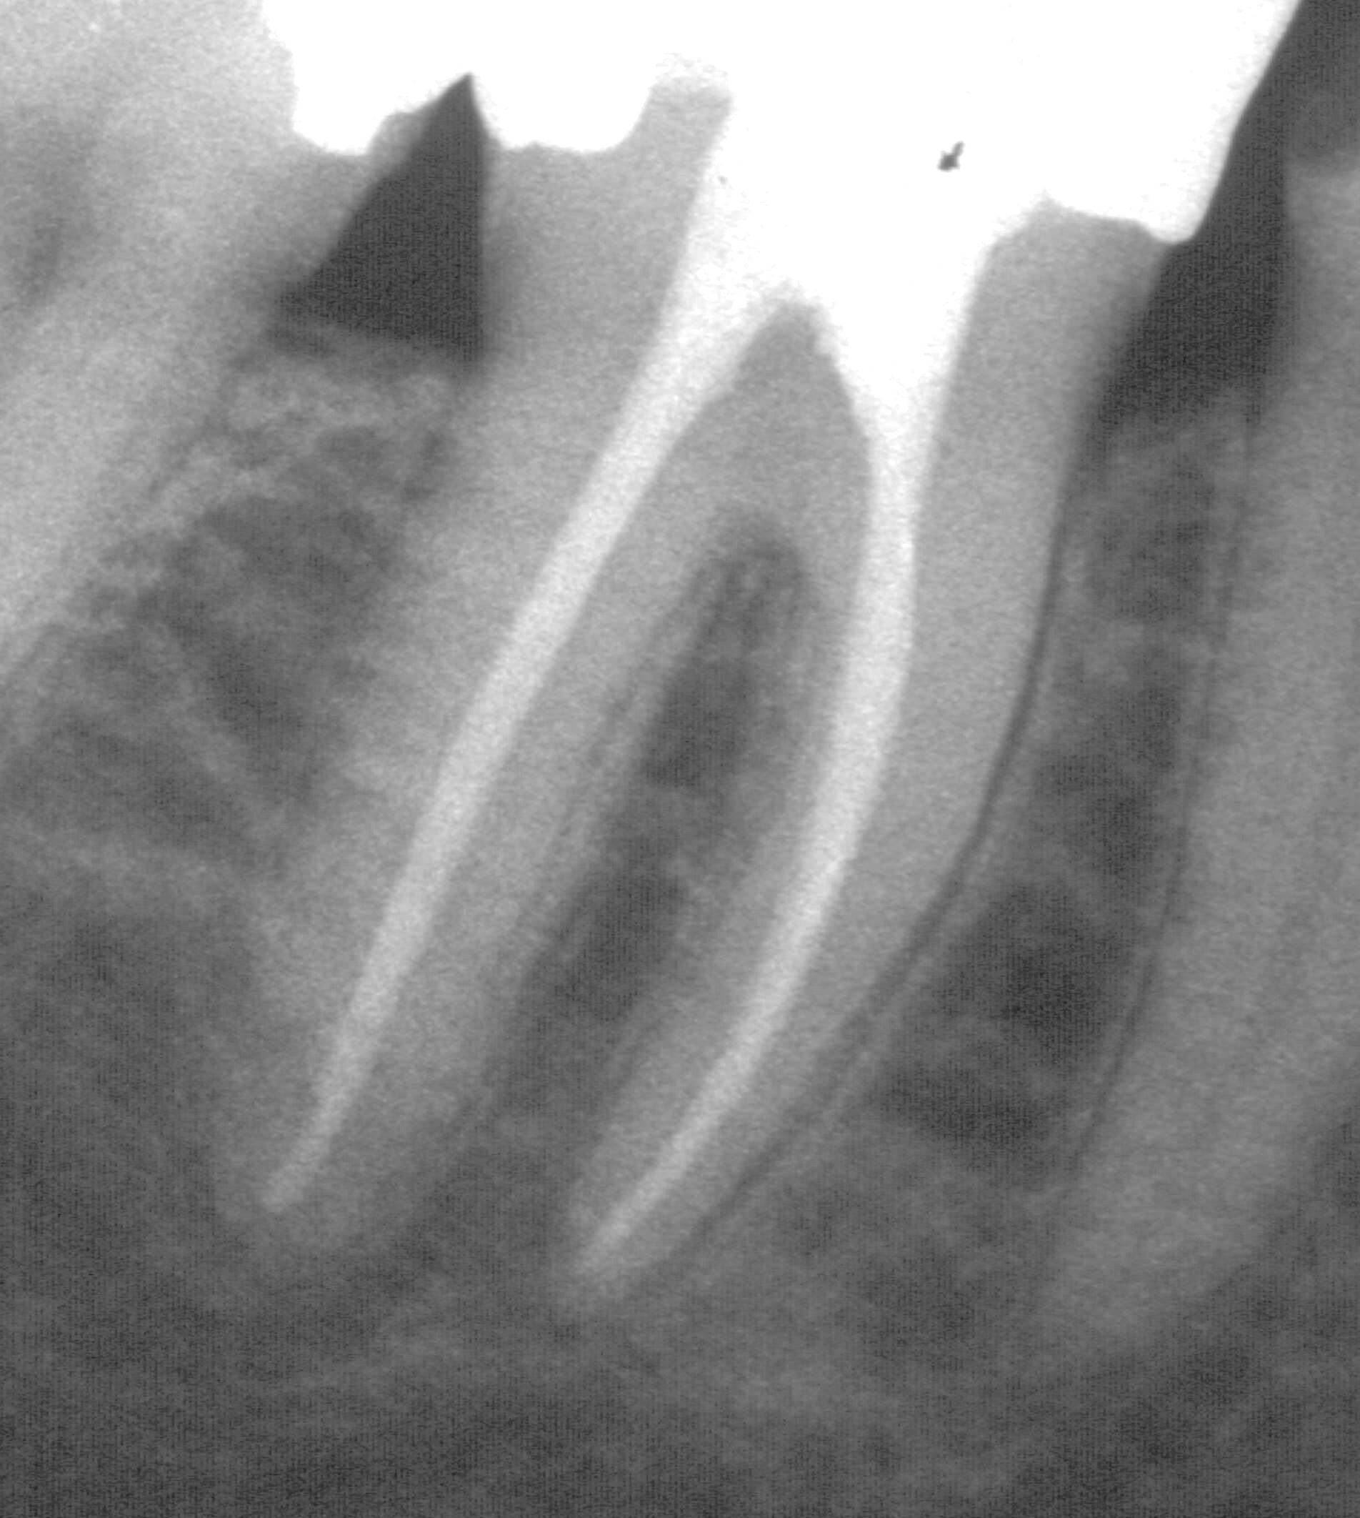
Simple endodontic infections
Caries
Crown fracture of limited extent
Pulpitis
  reversible
  Irreversible
Pulpal infection
Pulpal necrosis
  Not necessarily a lesion,
  not even infected
Primary apical periodontitis

Slide 15
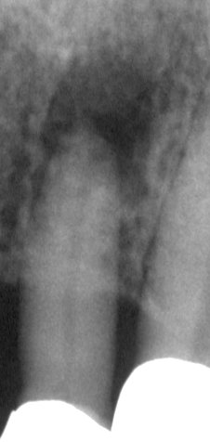
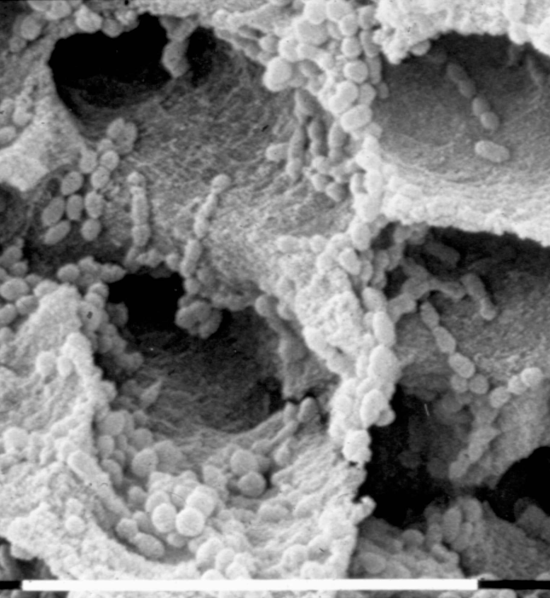
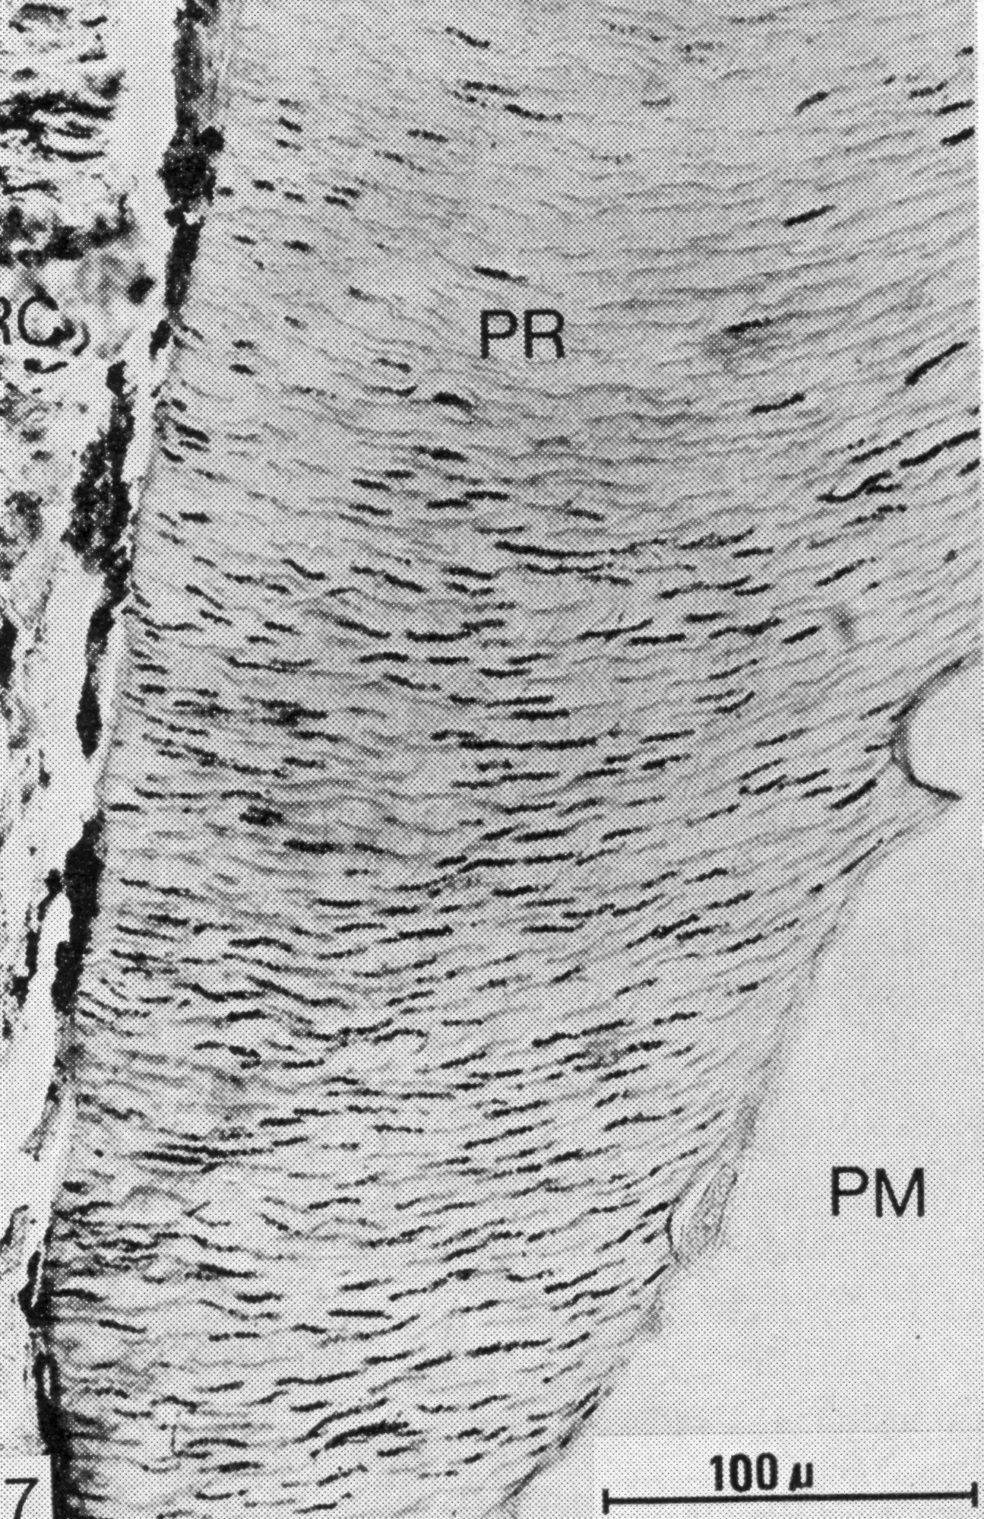
Simple endodontic infections
Caries
Crown fracture of limited extent
Pulpitis
  reversible
  Irreversible
Pulpal infection
Pulpal necrosis
Primary apical periodontitis

Slide 16
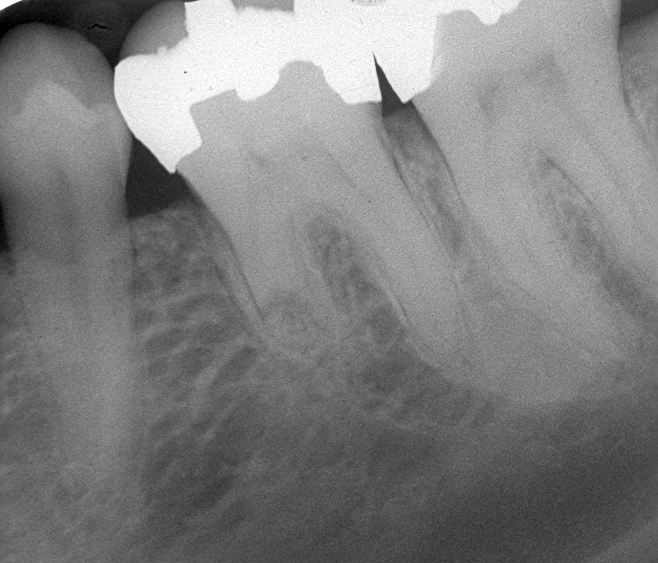
Complex endodontic infections
Partial pulpal infection
Endo-perio situations
pulp exposure of long duration
Secondary apical periodontitis
Persistent apical periodontitis
Root resorptions
  Traumatic, infectious
    Inflammatory and replacement resorption
  Internal resorptions
  Cervical resorptions
Medical conditions of consequence

Slide 17
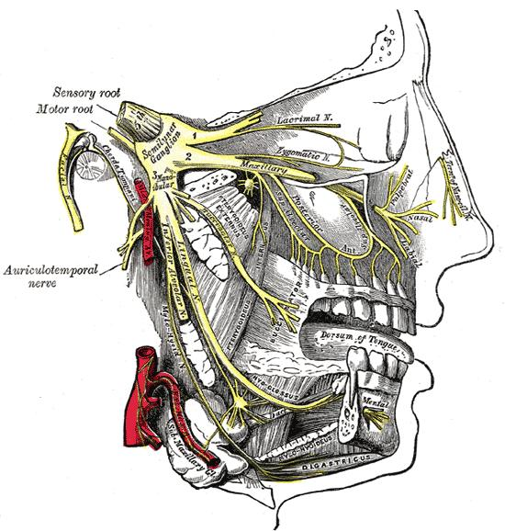
Complex endodontic infections
Partial pulpal infection
Endo-perio situations
Secondary apical periodontitis
Persistent apical periodontitis
Root resorptions
  Traumatic, infectious
    Inflammatory and replacement resorption
  Internal resorptions
  Cervical resorptions
Medical conditions of consequence

Slide 18
Complex endodontic infections
Partial pulpal infection
Endo-perio situations
Secondary apical periodontitis
Persistent apical periodontitis
Root resorptions
  Traumatic, infectious
    Inflammatory and replacement resorption
  Internal resorptions
  Cervical resorptions
Medical conditions of consequence

Slide 19
Complex endodontic infections
Partial pulpal infection
Endo-perio situations
Secondary apical periodontitis
Persistent apical periodontitis
Root resorptions
  Traumatic, infectious
    Inflammatory and replacement resorption
  Internal resorptions
  Cervical resorptions
Medical conditions of consequence

Slide 20
Complex endodontic infections
Partial pulpal infection
Endo-perio situations
Secondary apical periodontitis
Persistent apical periodontitis
Root resorptions
  Traumatic, infectious
    Inflammatory and replacement resorption
  Internal resorptions
  Cervical resorptions
Medical conditions of consequence
Neuropathy mechanism

Slide 21
Complex endodontic infections
Partial pulpal infection
Endo-perio situations
Secondary apical periodontitis
Persistent apical periodontitis
Root resorptions
  Traumatic, infectious
    Inflammatory and replacement resorption
  Internal resorptions
  Cervical resorptions
Medical conditions of consequence

Slide 22
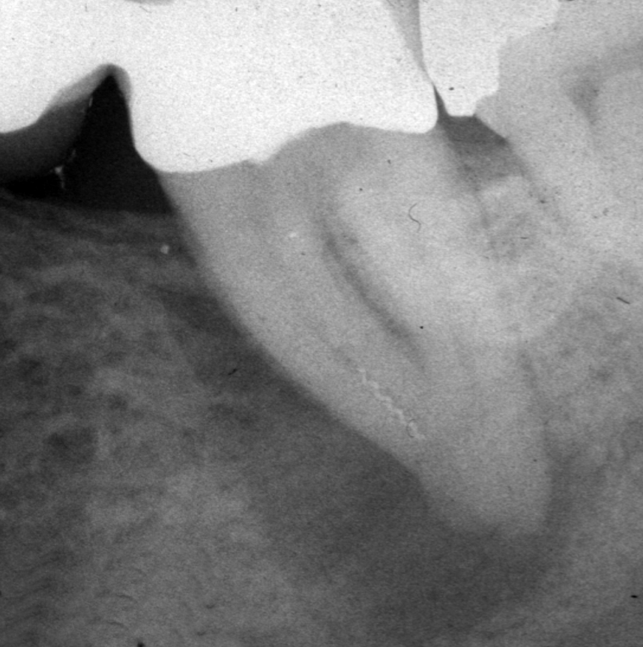
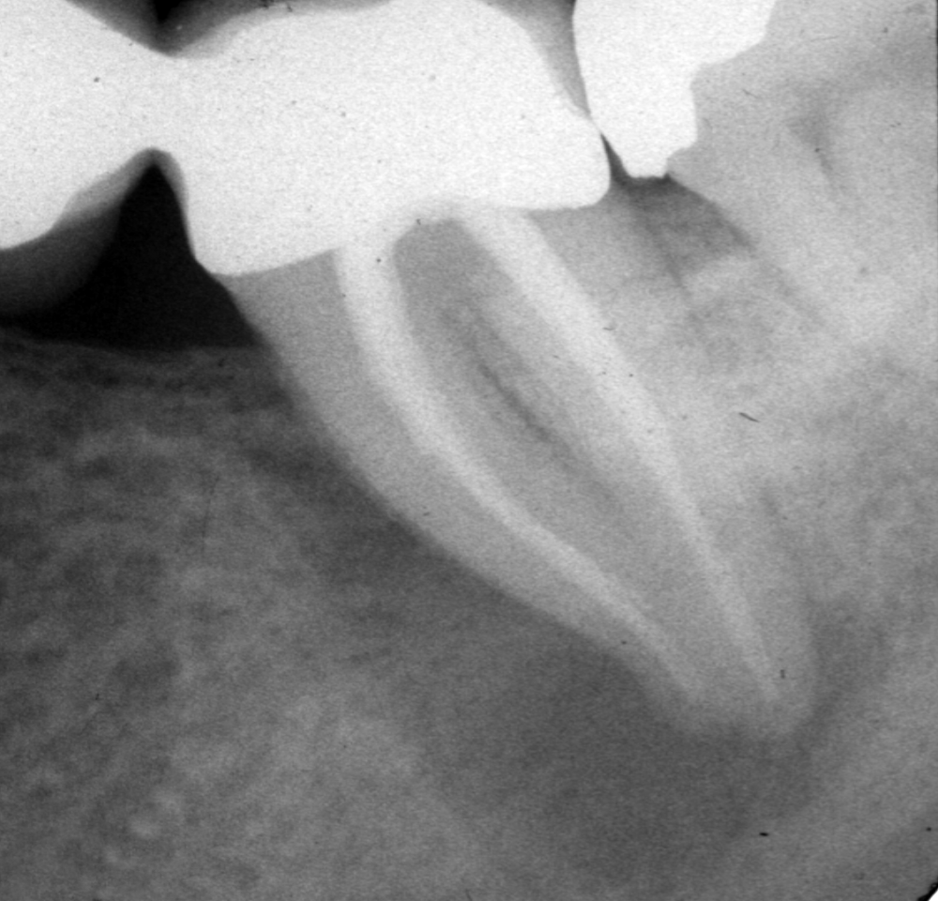
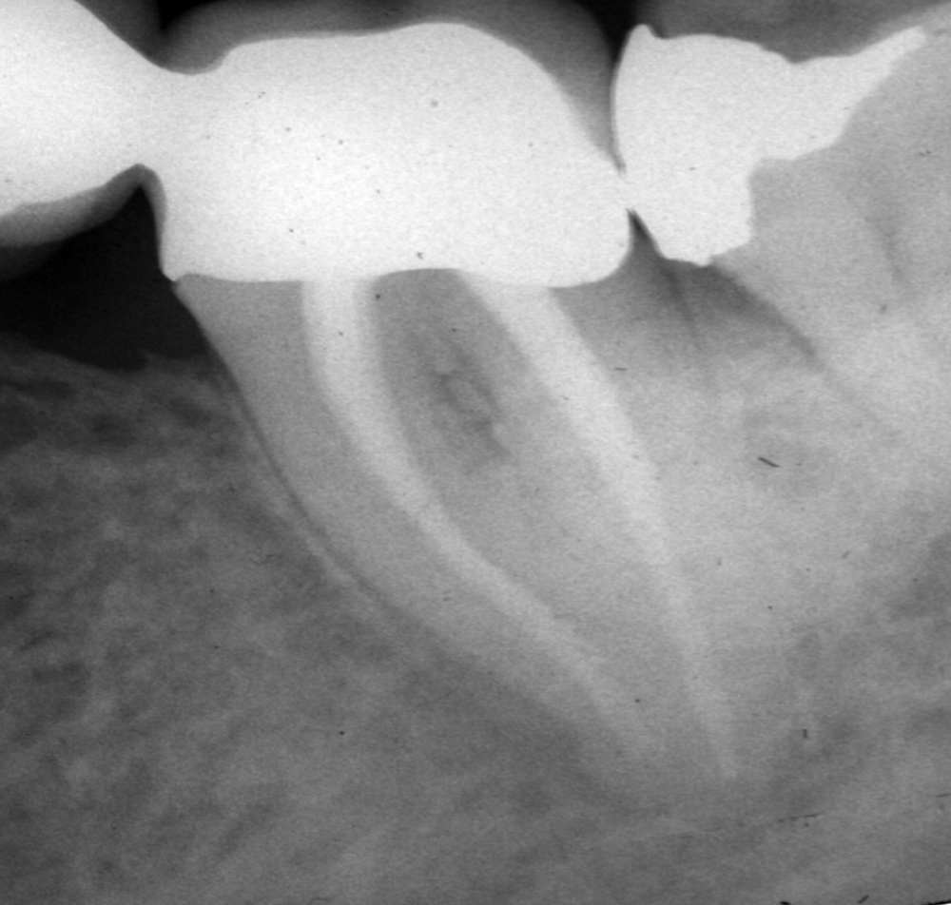
971116 971209
981209
Large lesion, periodontal sinus tract,
fractured file

Slide 23
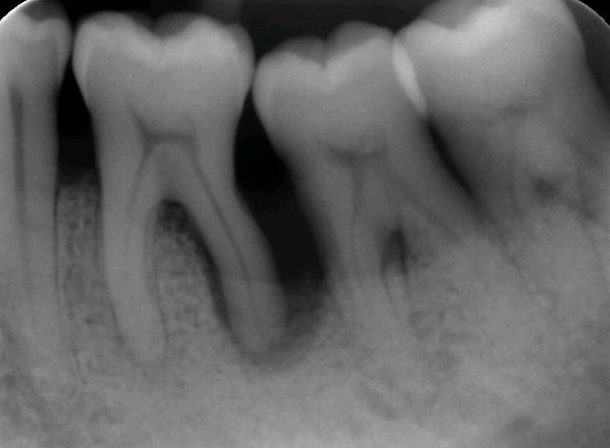
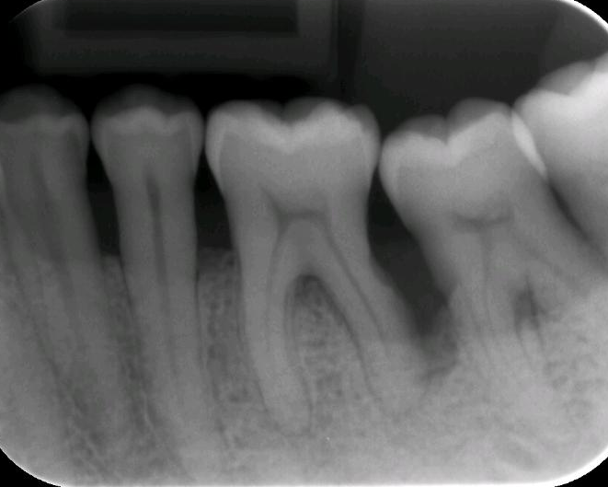
Endo-perio:
The golden rule:
Separate diagnoses,
one for perio,
and above all,
one for endo
If pulp necrotic; endo first, no problem.
If pulp responds, NO endo,
except as last resort in multirooted teeth

Slide 27
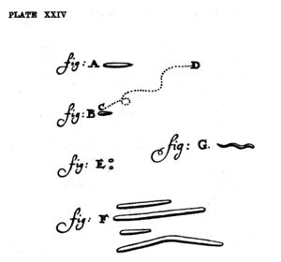
Bacteriology
Leeuwenhoek:
Miller
Kakehashi
Bergenholtz
Katz
Sundqvist
Möller
Siqueira
Deep caries
Pulpal contamination
Pulpal infection
Canal system infestation
Cementum colonization
Extraradicular locations

Slide 28
Bacteriology
Leeuwenhoek
Miller 1889:
Delineated the pulpal infection processes:
Kakehashi
Bergenholtz
Katz
Sundqvist
Möller
Siqueira
Deep caries
Pulpal contamination
Pulpal infection
Canal system infestation
Cementum colonization
Extraradicular locations
Progressive suppurative
Total purulent: classical acute pulpitis
Necrosis, then infection
Seeding to bloodstream
Anachoresis
From 1914 to 1966 and more : 50 years of misconceptions, the hollow tube theory and the theory of material toxicity

Slide 29
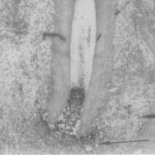
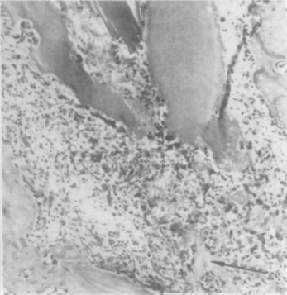
Bacteriology
Conventional
Leeuwenhoek
Miller
Kakehashi et al 1965:
Germfree rats did
not develop apical periodontitis
Bergenholtz
Katz
Sundqvist
Möller
Siqueira
Germ-free

Slide 30
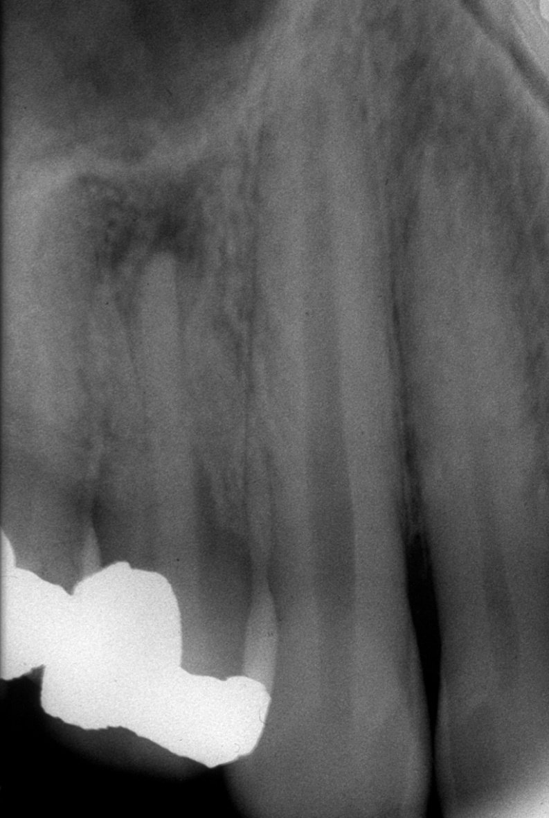
Bacteriology
Leeuwenhoek
Miller
Kakehashi
Bergenholtz
Katz
Sundqvist:
If no bacteria, no lesion
Möller
Siqueira

Slide 31
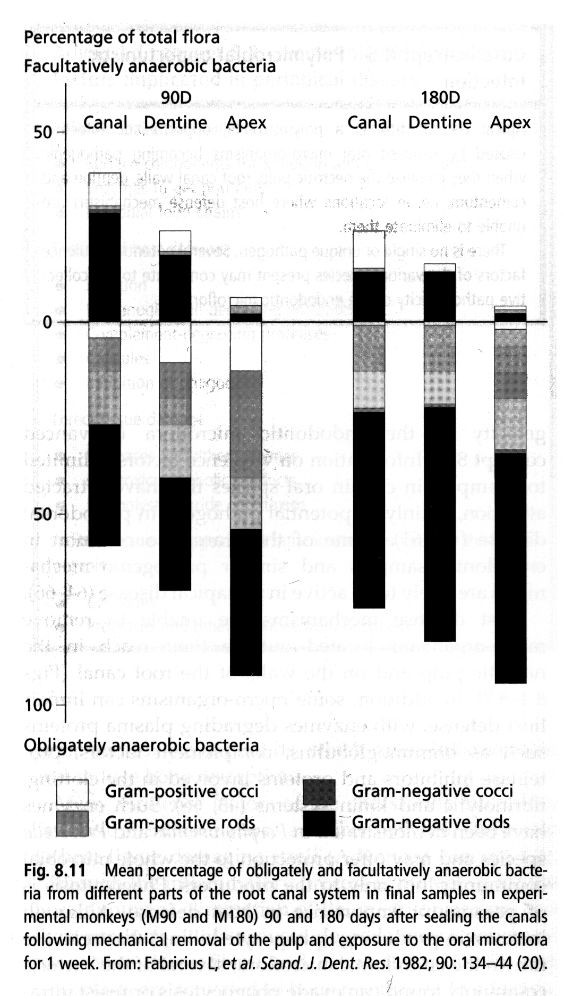
Bacteriology
Leeuwenhoek
Miller
Kakehashi
Bergenholtz
Katz
Sundqvist
Möller:
Ecology of microorganisms in the root canal
Siqueira

Slide 32
Bacteriology
Leeuwenhoek
Miller
Kakehashi
Bergenholtz
Katz
Sundqvist
Möller
Siqueira:
molecular and genetic methods for characterization
A better understanding of the differential colonization at different locations and in different stages of infection
Siqueira in Ørstavik & Pitt Ford: Essential Endodontology, 2008

Slide 33
Bacteriology
Primary apical periodontitis
  Complex, but managable microbial flora
  Do it right first time
  If you don’t have the time to do it right, when will you find the time to do it over?
Secondary and persistent apical periodontitis
  Other microbes move in to take center stage
  Some may be resistant, but of low pathogenicity,
  others of very high pathogenicity

Slide 34
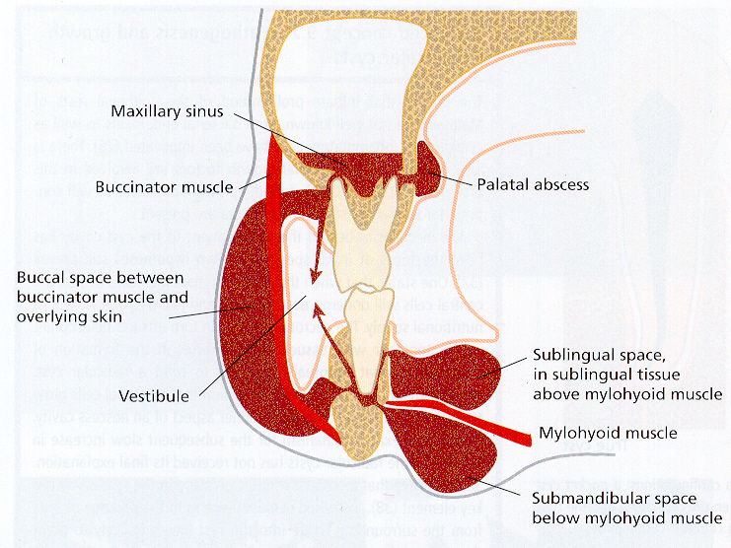
Problem 1: Spread
Bergenholtz G, Hørsted-Bindslev P, Reit C.
Textbook of Endodontology 2003

Slide 35
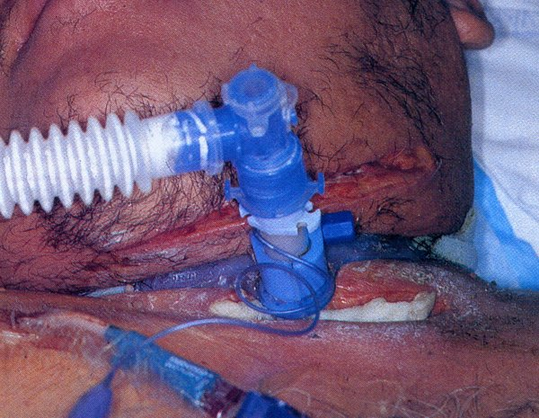
Day 1: ENT admission: parenteral penV + Metronidazole
Day 2: Oral surgeon consult: drainage, pus evident
Day 3: 40 Centigrade
Day 4: 38 C, Tienam 0,5 g x 4, extensive surgery
Day 5: Radiography: mediastenitis
Day 6: Explorative laparotomy: duodenal ulcer
Day 15: Spontaneous rupture abdomen
Day 16: Multiple organ failure – sepsis
Day 22: Mors
Problem 2: The compromised host
Dental diagnosis:
’periapical destruction tooth no. ISO47’
Adielsson et al.
Tandläkartidningen 2000; 92:32-40

Slide 36
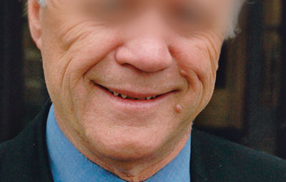
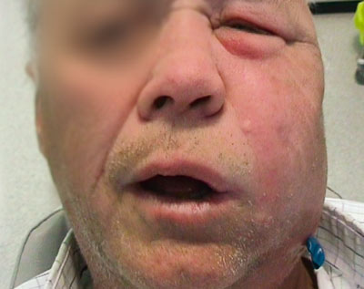
Necrotizing fasciitis
Nor Tannlegeforen Tidende 2009; 119: 222 – 4
Pål Galteland, Oddvar Moen, Haris Mesic og Per Skjelbred
Problem 3: The unexpected pathogen

Slide 37
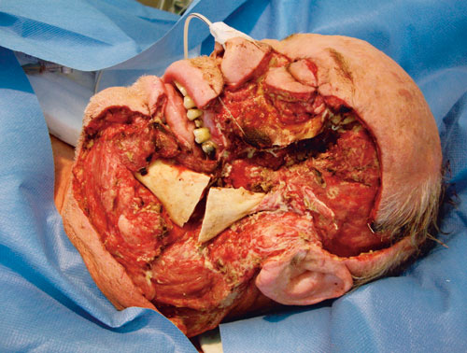
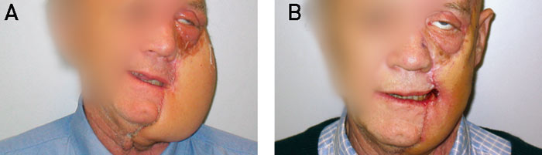
Necrotizing fasciitis
Nor Tannlegeforen Tidende 2009; 119: 222 – 4
Pål Galteland, Oddvar Moen, Haris Mesic og Per Skjelbred
Tooth number ISO 37
Unclear history, but regular endodontic treatment initiated
Warning sign: massive pus exodus on opening (35 minutes)

Slide 38
Endodontic treatment and cardiovascular events
The relationship between self-reported history of endodontic therapy and coronary heart disease in the Atherosclerosis Risk in Communities Study.
Caplan DJ, Pankow JS, Cai J, Offenbacher S, Beck JD.
J Am Dent Assoc. 2009 Aug;140(8):1004-12.
Problem 4: The incidious consequences

Slide 39
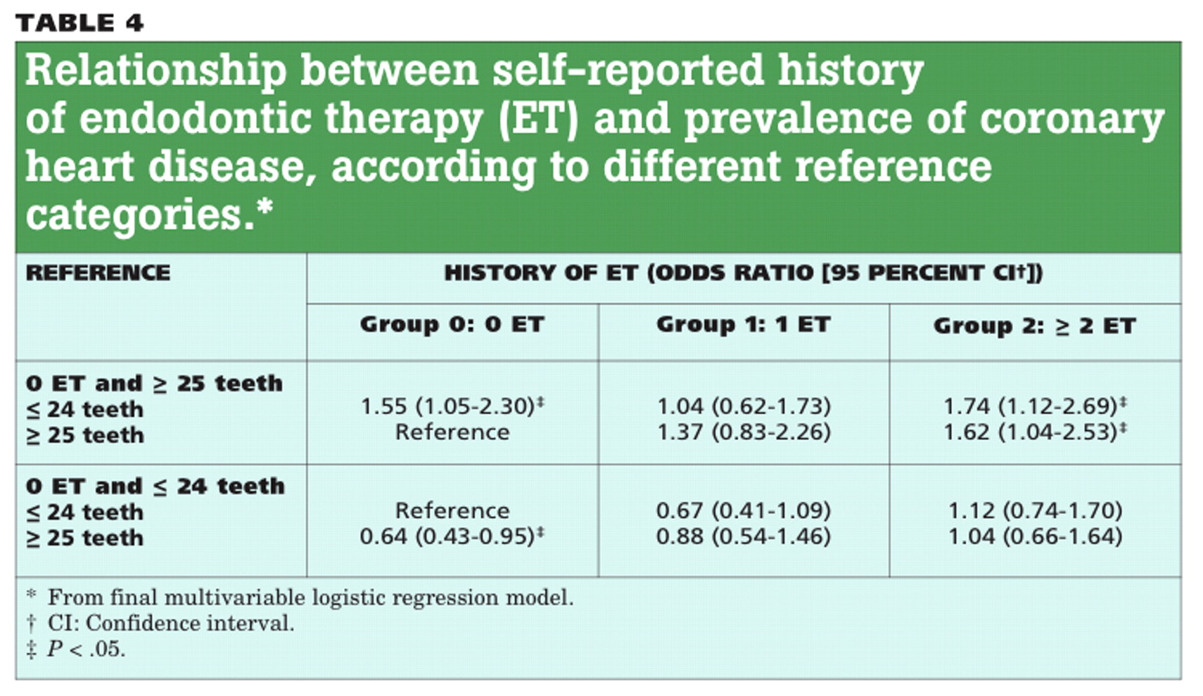
Endodontic infections and cardiovascular events

Slide 40
Endodontic infections and cardiovascular events
Of 6,651 participants analyzed, 50.4 percent reported never having had ET; 21.5 percent reported having had ET one time; and 28.0 percent reported having had ET two or more times. Final multivariable regression models indicated that among participants with 25 or more teeth, those reporting having had ET two or more times had 1.62 (95 percent confidence interval [CI], 1.04–2.53) times the odds of prevalent CHD compared with those reporting never having had ET. Among participants with 24 or fewer teeth, no significant differences in CHD prevalence were observed among groups regardless of their history of ET.

Slide 41
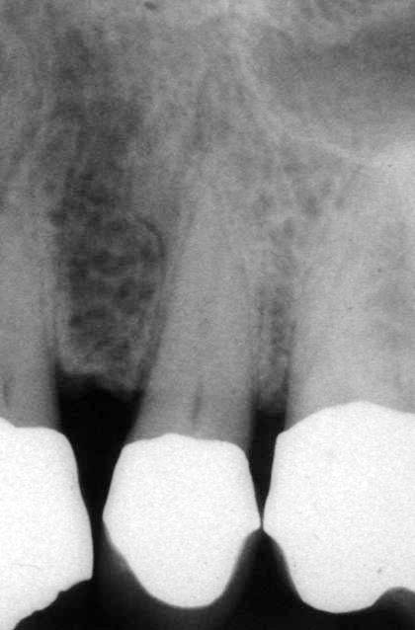
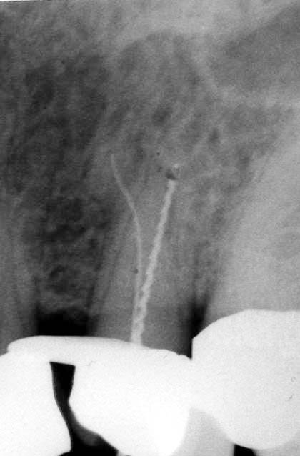
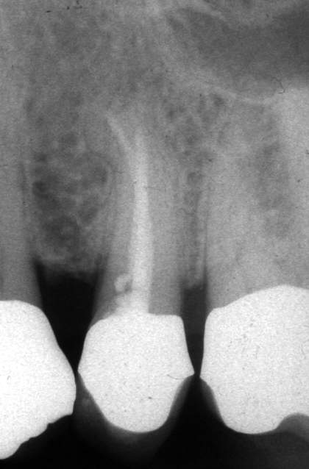
The other extreme
Primary, conventional root canal infection

Slide 42
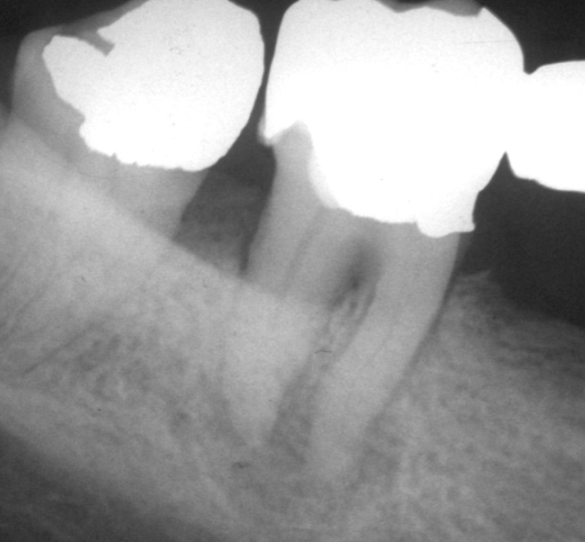
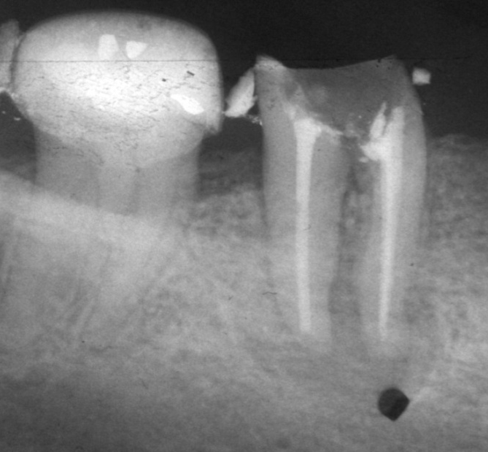
The other extreme
Primary, conventional root canal infection
Implant?

Slide 43
The other extreme
Primary, conventional root canal infection
1981
1981

Slide 44
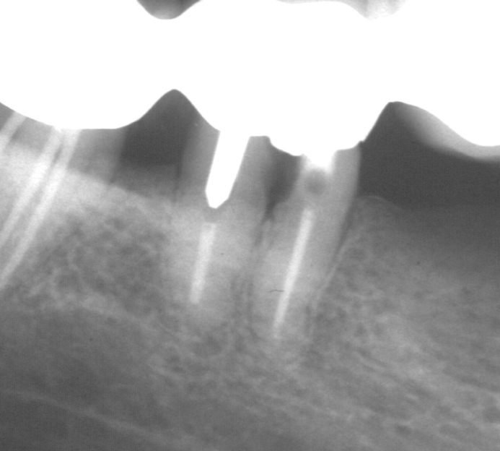
The other extreme
Primary, conventional root canal infection
1981
1981
2006

Slide 45
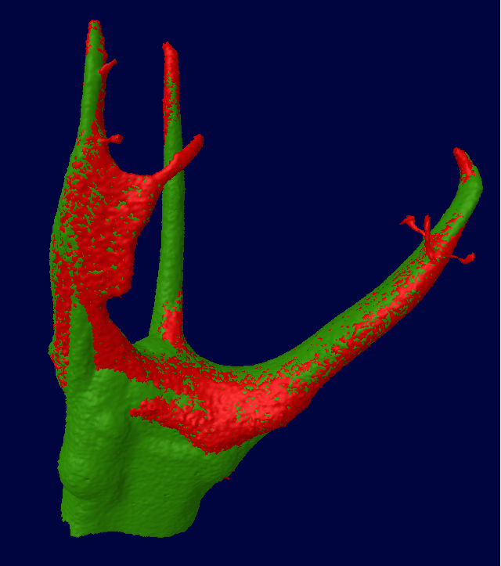
A breather slide

Slide 46
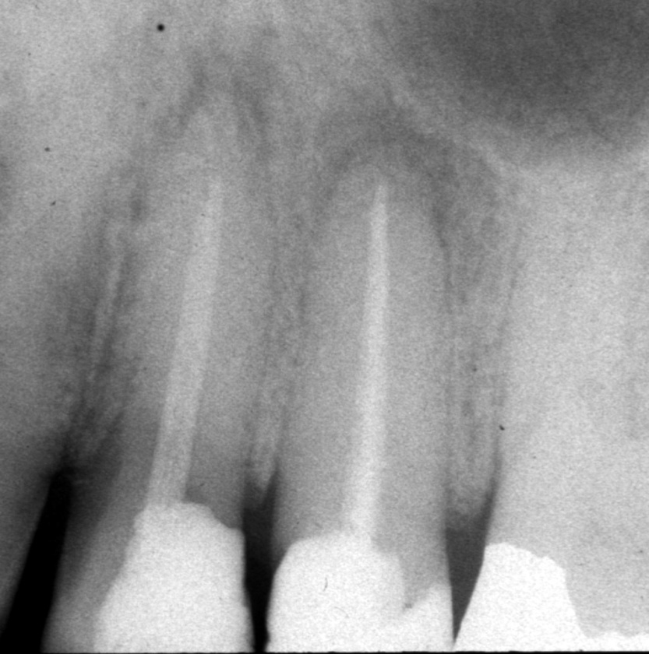
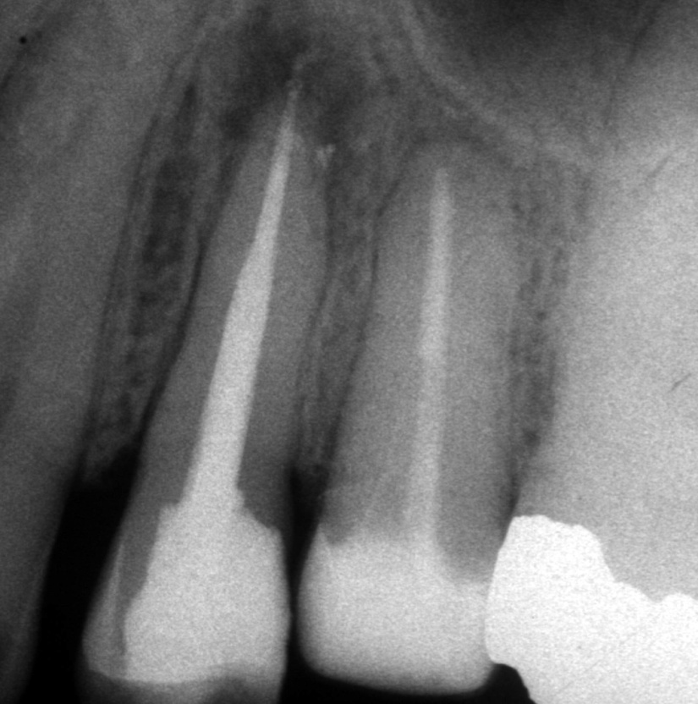
More difficult
Secondary and/or persistent root canal infection
1999
2002

Slide 47
More difficult: ”failures”, ie, secondary or persistent apical periodontitis
Prevalence of Enterococcus faecalis in endodontic infections associated with different forms of periradicular diseases. AAP, acute apical periodontitis; AAA, acute apical abscess; CAP, chronic apical priodontitis. Data according to Rôças et al. 2004 (Ess Endo)
Low pathogenicity, but high resistance

Slide 48
Location of microbes
Pulpal infection
Canal system infestation
Cementum colonization
Extraradicular locations
AP
4
3
2
PDL
P
1

Slide 49
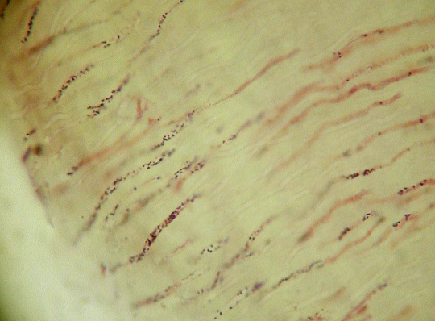
Tubule infection
AP
4
3
2
PDL
From Valderhaug 1972
From Siqueira in Ørstavik & Pitt Ford: Essential Endodontology, 2008
Problem mainly in location, also in resistance: streptococci grow into tubules, G- rods do not easily
P
1

Slide 50
Cementum surface
AP
4
3
2
PDL
P
1
From Siqueira in Ørstavik & Pitt Ford: Essential Endodontology, 2008
Problem mainly in location, secondarily in resistance

Slide 51
Antibacterial efforts
Instrumentation and irrigation
Dressing and time-dependent killing
Obturation
AP
PDL
P

Slide 52
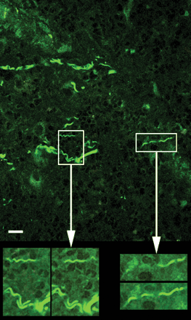
Extraradicular locations
AP
4
3
2
PDL
P
1
From Sunde et al 2003. Problem mainly in location, secondarily in resistance

Slide 53
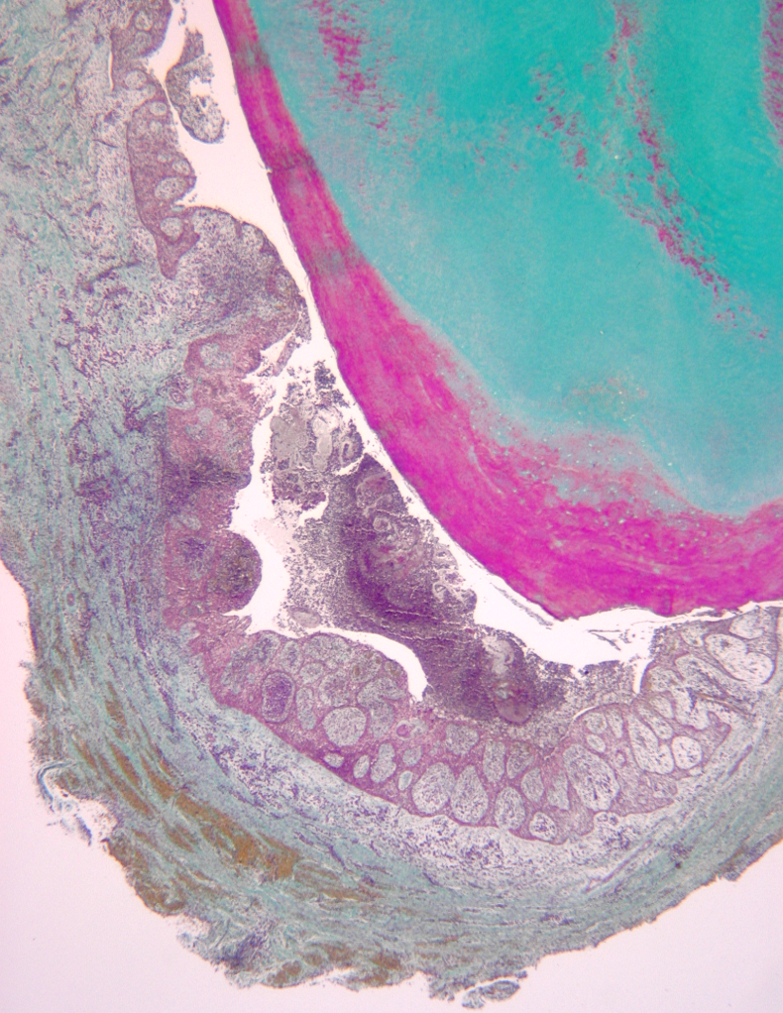
Location of microbes
AP
4
3
2
PDL
P
1
From Siqueira (Riccucci) in Ørstavik & Pitt Ford: Essential Endodontology, 2008
Problem in location and in resistance of actinomyces and similar organisms

Slide 54
Summing up on bacteriology
Deep caries
Pulpal contamination
Pulpal infection
Canal system infestation
Cementum colonization
Extraradicular locations
The diagnostic challenge is to assess the localization of the microbes

Slide 55
Pathogenesis
Infectious agents
  Endotoxins
  ”Pathogen associated factors”
  Cytokines
  Antigens
  Viral agents
Other factors
  cellulose
Innate defense
  Tlr’s
  Complement cascade
  Killer and phagocyting cells
Adaptive immune defense
  Antigen-presentation
  Humoral
  Cellular

Slide 56
Fig. 3.1. Pathways of periapical inflammation and bone destruction.
Periapical inflammation
& bone destruction
Arachidonic acid
metabolites
Neuropeptides
Cytokines
Connective
tissue cells
Nerves
Immune cells
Bacterial components
Fig. 3.1

Slide 57
Osteoclastic
bone resorption
IFNα, GM-CSF, TNFα
IL-1, TNFα, IL-11
IL-4,-6,-8,-10,-13
Th1 cells
Th2 cells
IL-10
IL-10
Macrophages,
dendritic cells
Bacterial components
Fig. 3.7

Slide 58
The resorptive process
Denudation:
  Cementum
  Predentin
Remodelling:
  Deposition
  resorption
Infectious/pathological
  Internal inflammatory
  External inflammatory
Physiological/protective
  Pressure induced
  Surface repair
  Replacement/ankylosis

Slide 59
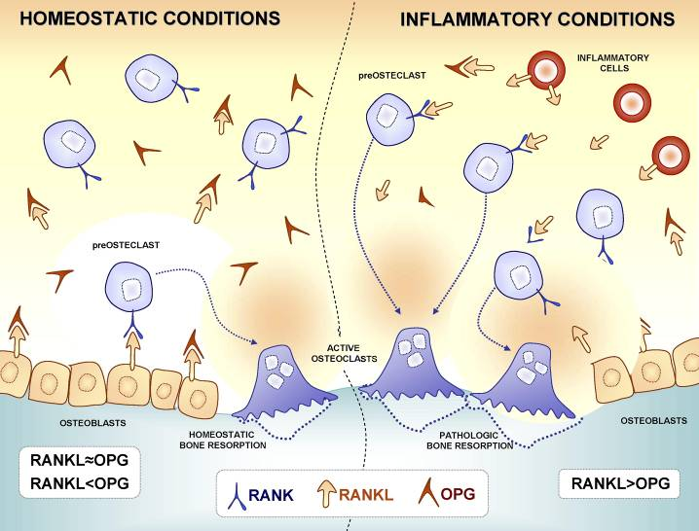
Menezes R, Garlet TP, Letra A, Bramante CM, Campanelli AP, Figueira Rde C, Sogayar MC, Granjeiro JM, Garlet GP. Differential patterns of receptor activator of nuclear factor kappa B ligand/osteoprotegerin expression in human periapical granulomas: possible association with progressive or stable nature of the lesions.
J Endod. 2008 Aug;34(8):932-8

Slide 60
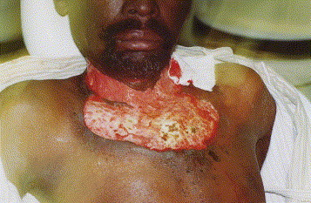
Pathogenesis affected by systemic conditions?
Necrotizing Fasciitis of Cervical Region in AIDS.
M.M. Chidzonga. J Oral Maxillofac Surg 2005.
FIGURE 2. Appearance after total debridement.M.M. Chidzonga. Necrotizing Fasciitis of Cervical Region in AIDS. J Oral Maxillofac Surg 2005.
Appearance after total debridement.
Generally, there are no clinical differences in response to treatment in immunosuppressed patients

Slide 61
High prevalence of apical periodontitis amongst type 2 diabetic patients.
Segura-Egea JJ, Jiménez-Pinzón A, Ríos-Santos JV, Velasco-Ortega E, Cisneros-Cabello R, Poyato-Ferrera M.
Int Endod J. 2005 Aug;38(8):564-9.

Slide 62
Pathogenesis
Research on the pathogenesis from dentin infection to pulpitis to pulpal disintegration to periapical inflammation and bone resorption reveals an increasing amount of cytokines potentially susceptible to pharmaceutical regulation
Diabetes is a prime example of the modification of pathogenic processes by geno- or phenotypic variations in protective mechanisms for infection defenses: generally, this is the only disease for which an association with increased prevalence of apical periodontitis is shown

Slide 63

Are dental responses to infections of the primordial kind?
Cell death and apoptosis MAY induce and sustain inlammation bypassing immune recognition mechamnisms
Damage-associated molecular patterns (DAMPs), pathogen-associated molecular patterns (PAMPs),

Slide 64
Toxicity – necrosis – infections
Toxicity alone is insufficient to cause permanent damage
Pulpal necrosis alone has no impact on periapical conditions
Infection at any level of the pulp canal system is essential
Infection may be unrelated to toxic effects (of materials) or pulpal necrosis
Traditional concept

Slide 65
Modern concepts – a paradigm change?
Composites and glass ionomers
Insufficient curing common
Leakage of unreacted monomers
Modifies cell metabolism
Induces cell apoptosis
Increases p53:
  p53 has been described as "the guardian of the genome", referring to its role in conserving stability by preventing genome mutation.

Slide 66
Traditional dimetacrylates
Bis-GMA
Bowen’s monomer
Bisfenol A - diglycidylmetacrylate
TEGDMA
Triethylenglycol-dimetacrylate

Slide 67

”New” dimetacrylates
Ethoxylated Bis-GMA
Bis-EMA
UDMA
Uretan-dimetacrylate

Slide 68


Modern concepts – paradigm change
Increased apoptosis and p53 levels in cell culture
p53 has been described as "the guardian of the genome", the "guardian angel gene", and the "master watchman", referring to its role in conserving stability by preventing genome mutation.

Slide 69

Modern concepts – paradigm change
Secretion of IL-8 from BEAS-2B cells exposed to 5–80 lg/cm2 of filler particles for 24 h. IL-8 attracts neutrophil granulocytes

Slide 70


Clinical manifestations
”Somato-sensoric dysfunction”: mechanical and thermal (cold) allodynia; skin paresthesia
Extending from a source area
Autonome dysfunction (tears, nasal secretion)

Slide 71
Non-odontogenic conditions
• Sinusitis
• Muscular pain and TMD
• Referred pain
• Trigeminus neuralgia
• Herpes zoster
• Multiple sclerosis
• Tumors
• Migrene
• ’Cluster headache’
• TMJ
• Pain from salivary glands
• Angina pectoris
• Cheaters
• ’Munchhausen’
• Atypical; neuropathic pain

Slide 72
Atypical pain; phantom pain; neuropathia

Slide 73

Hargreaves & Goodis, 2002

Slide 74
Atypical pain; phantom pain; neuropathia
Negative sign: local pathosis eliminated or cleared from suspicion
Persistent and prolonged: for months;
increasing from the morning on,
no sleeping problems
”Somato-sensoric dysfunction”:
mechanical and thermal (cold) allodynia; skin paresthesia
Expanding from a source area (multiple root fillings)
Autonome dysfunction (tears, nasal secretion)
Caveat: Similar symptoms with subacute infections; eg, chronic pulpitis and chronic apical periodontitis

Slide 75
Diagnostic tools
Clinical
  Inspection, percussion, palpation, mobility, tooth sleuth
Radiographical
  Conventional PA, CBCT, CT, ultrasound
Anamnestic and medical
  Establishing the conditions at the battlefield:
    Where are the microorganisms?
    Which are they?
    What state is the tissue in?
  Subjective symptoms seldom pathognomonic

Slide 76



120 minutes or 120 meters
Thank you for your attention!

Slide 77
”Tumor”: Swelling
Diagnosis of spreading infections
  Abscess formation in distant organs
  Ludwig’s angina
  Necrotizing fasciitis
  Patients with reduced immune function

