Slide 1
The evidence base for endodontic procedures
Guadalajara 2010

Slide 2
Modern Norway 200 years May 17 2014

Slide 4
What is evidence-based dental practice?
Three elements (often forgotten)
Science base
Even if you cannot perform it, you should know the best known diagnostic or treatment procedure for the condition evaluated
Skills of health provider
Know thyself, primum non nocere
Do the best you can. If you don’t master what is best, don’t try it; discuss, refer
Patient’s needs and desires after adequate information
Desires may be adjusted up or down. Never sell!

Slide 5
Science Base
The classical pyramid of evidence
High-Level Evidence
Systematic Clinical Experiments
RCT
Cohort
Case-Control
Case-Series
Low-Level Evidence
Animal and Lab Studies, Biological Plausibility, Expert Opinion
From Lesaffre et al 2009

Slide 6
Levels of evidence
Clinical
RCTs (prosp)
Cohort studies (r&p)
Case controls (r&p)
(Matched pairs)
Case series (r&p)
Case collection (r&p)
”Inferential”
Animal studies
Cell and tissue culture
Ex vivo teeth
Chemical properties
Physical properties
Technological aspects

Slide 7
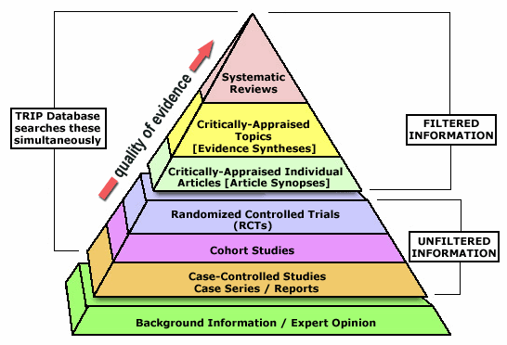
Science Base
The classical pyramid of evidence
Meta- Analyses
from http://www.galter.northwestern.edu/Guides-and-Tutorials/ebm-resources

Slide 8
What is an RCT?
Randomisation: any element in the study has an equal chance of exposure to the treatment element being studied
Randomized Clinical Trial – extremely successful for development of pharmaceutical products
A new method/new material/new drug tested against a standard control – few questions are asked!
Hypothesis testing
ALWAYS prospective

Slide 9
RCT: An Old Example
Two ”new” root filling materials against the traditional
Enrolment and treatment identical for all three
Material assigned at random just before filling
Control up to 4 years
Patient was unaware of selection
Scorer did not know which material had been used

Slide 10
RCT: An Old Example
Two ”new” root filling materials against the traditional
Enrolment and treatment identical for all three
Material assigned at random just before filling
Control up to 4 years

Slide 11
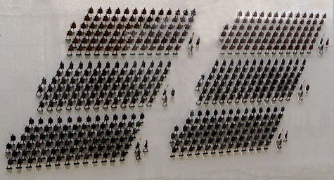
What is a cohort study?
Cohort – a roman military unit
an ancient Roman military unit of 300-600 men, constituting one tenth of a legion
A group of individuals followed over time
A hypothesis is not necessary
May have different origins – take endodontic treatment in two or more locations

Slide 12
The prognosis of root canal therapy: a 10-year retrospective cohort study on 411 patients with 1175 endodontically treated teeth. Fonzar F, Fonzar A, Buttolo P, Worthington HV, Esposito M. Eur J Oral Implantol. 2009 Autumn;2(3):201-8.

Slide 13
The prognosis of root canal therapy: a 10-year retrospective cohort study on 411 patients with 1175 endodontically treated teeth. Fonzar F, Fonzar A, Buttolo P, Worthington HV, Esposito M.
Eur J Oral Implantol. 2009 Autumn;2(3):201-8.
PURPOSE: To evaluate the 10-year prognosis of consecutively endodontically treated or retreated teeth and to investigate some of the prognostic factors which could predict the long-term outcome of endodontic therapy.
MATERIALS AND METHODS: This retrospective cohort study included any patient who had endodontically treated or retreated teeth from 1986 to 1998 by a single operator in a private practice. Outcome measures were clinical and radiographic success assessed by the operator, radiographic success assessed by an independent outcome assessor and complications evaluated 10 years after treatment. Descriptive statistics, life table, Kaplan-Meier and Cox regression analyses for success were fitted.
RESULTS: A total of 411 patients with 1175 endodontically treated teeth were identified. Ten years after treatment 102 patients (24.8%) with 223 (19.0%) teeth were lost at the follow-up. The number of teeth that were originally treated and retreated were 704 and 471, respectively. Thirty-two teeth (2.7%) had one complication, which was successfully treated. A total of 988 (84.1%) teeth were considered a complete success, 46 (3.9%) a partial success, 52 (4.4%) a partial failure and 68 (5.8%) had to be extracted according to the treating clinician. For 21 teeth (1.8%) there was no follow-up information. The radiographic healing of 1086 teeth was evaluated by an independent assessor: 980 (90.2%) showed complete healing, 52 (4.8%) improvement, and 54 (5.0%) no change or worsening. The life-table analysis showed 93% of teeth surviving at 10 years after endodontic treatment. There were no differences for survival rates between teeth treated for the first time and those that were retreated (Kaplan-Meier). Teeth retreated because of symptoms or for a periapical/lateral radiolucency were more likely to fail.
CONCLUSIONS: Approximately 7% of endodontically treated teeth were extracted 10 years after treatment. Symptoms and radiolucency of teeth needing retreatment may be important predictors for failure.

Slide 14
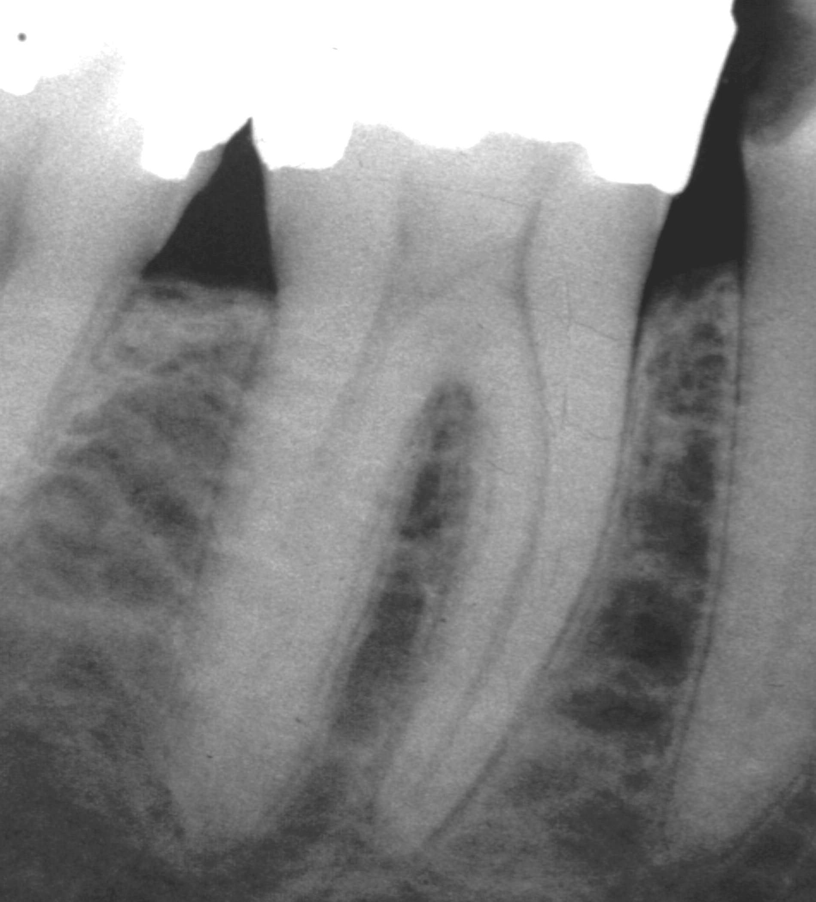
The prognosis of root canal therapy: a 10-year retrospective cohort study on 411 patients with 1175 endodontically treated teeth. Fonzar F, Fonzar A, Buttolo P, Worthington HV, Esposito M.
A single operator in a private practice:
Approximately 7% of endodontically treated teeth were extracted 10 years after treatment. Symptoms and radiolucency of teeth needing retreatment may be important predictors for failure.

Slide 15
The prognosis of root canal therapy: a 10-year retrospective cohort study on 411 patients with 1175 endodontically treated teeth. Fonzar F, Fonzar A, Buttolo P, Worthington HV, Esposito M.
Weaknesses:
Often, confounding variables cannot be identified with certainty.
There is erosion of the number of subjects studied, and
it is difficult to sort out bias in the provision of treatment (unrecorded factors of possible influence).
Strengths:
A cohort study is the best way to identify incidence and natural history of a disease, and
Is useful to calculate incidence rates, relative risks, and 95% CIs.
Eur J Oral Implantol. 2009 Autumn;2(3):201-8.
PURPOSE: To evaluate the 10-year prognosis of consecutively endodontically treated or retreated teeth and to investigate some of the prognostic factors which could predict the long-term outcome of endodontic therapy.
MATERIALS AND METHODS: This retrospective cohort study included any patient who had endodontically treated or retreated teeth from 1986 to 1998 by a single operator in a private practice. Outcome measures were clinical and radiographic success assessed by the operator, radiographic success assessed by an independent outcome assessor and complications evaluated 10 years after treatment. Descriptive statistics, life table, Kaplan-Meier and Cox regression analyses for success were fitted.
RESULTS: A total of 411 patients with 1175 endodontically treated teeth were identified. Ten years after treatment 102 patients (24.8%) with 223 (19.0%) teeth were lost at the follow-up. The number of teeth that were originally treated and retreated were 704 and 471, respectively. Thirty-two teeth (2.7%) had one complication, which was successfully treated. A total of 988 (84.1%) teeth were considered a complete success, 46 (3.9%) a partial success, 52 (4.4%) a partial failure and 68 (5.8%) had to be extracted according to the treating clinician. For 21 teeth (1.8%) there was no follow-up information. The radiographic healing of 1086 teeth was evaluated by an independent assessor: 980 (90.2%) showed complete healing, 52 (4.8%) improvement, and 54 (5.0%) no change or worsening. The life-table analysis showed 93% of teeth surviving at 10 years after endodontic treatment. There were no differences for survival rates between teeth treated for the first time and those that were retreated (Kaplan-Meier). Teeth retreated because of symptoms or for a periapical/lateral radiolucency were more likely to fail.
CONCLUSIONS: Approximately 7% of endodontically treated teeth were extracted 10 years after treatment. Symptoms and radiolucency of teeth needing retreatment may be important predictors for failure.

Slide 16
What is a case-control study?
Two groups selected because they have different ”outcome”: disease, incident, discomfort
Case: example – exacerbations after root canal treatment
Control: example – individuals from the same population without exacerbation
Hypothetical variable: Blood glucose values in the two groups
Hypothesis: An indicator of diabetes is associated with increased incidence of exacerbation
Looking ”upstream” along biological plausibility

Slide 17
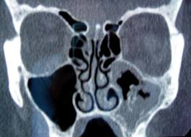
Maxillary fungal ball: Sinus mucosal infection with fungi - Aspergillus http://personal.fimnet.fi/laakari/hannu.tapiovaara/allerginen_sienisinuiitti.htm
Fungal ball (Aspergillus fumigatus)

Slide 18
Endodontic treatment: a significant risk factor for the development of maxillary fungal ball. Park GY, Kim HY, Min JY, Dhong HJ, Chung SK. Clin Exp Otorhinolaryngol. 2010 Sep;3(3):136-40.
Objectives. The risk factors for maxillary fungal ball are largely unknown. The aim of this study was to determine whether endodontic treatment of maxillary teeth is a risk factor for fungal ball development in the maxillary sinus, and to identify other possible risk factors.

Slide 19
Endodontic treatment: a significant risk factor for the development of maxillary fungal ball. Park GY, Kim HY, Min JY, Dhong HJ, Chung SK. Clin Exp Otorhinolaryngol. 2010 Sep;3(3):136-40.
Methods. One hundred and twelve case patients diagnosed with maxillary fungal ball (FB group) and age and gender matched control patients diagnosed with chronic paranasal rhinosinusitis (PNS group) were included to determine associations between previous endodontic treatment and maxillary fungal ball. In addition, we reviewed the dental extraction status of maxillary teeth and the underlying disease in both groups to analyze the other risk factors for maxillary fungal ball.

Slide 20
Endodontic treatment: a significant risk factor for the development of maxillary fungal ball. Park GY, Kim HY, Min JY, Dhong HJ, Chung SK. Clin Exp Otorhinolaryngol. 2010 Sep;3(3):136-40.
Results. There were 36.3% of patients in the FB group and 16.1% in the PNS group showed evidence of endodontic treatment on the maxillary teeth (P<0.001). Even after correction for possible confounding factor - the frequency of dental extractions - the rate of endodontic treatment remained higher in the FB group. The mean number of endodontically treated maxillary teeth in the FB group and PNS group were 0.63 and 0.27, respectively (P=0.001). In addition, 20.5% of the patients in the FB group and 13.4% in the PNS group has diabetes mellitus (P=0.154).
Conclusion. Endodontic treatment on maxillary teeth was a significant risk factor for the development of fungal balls in the maxillary sinus.

Slide 21
What is a case series?
A (prospective) study of results in one cohort with one special treatment or material
The outcome should be registered in such as way as to give meaningful comparison with similarly collected, historical data.
Cf the need for ”with homogeneity” in systematic reviews

Slide 22
What is a case series?
A (prospective) study of results in one cohort with one special treatment or material
The outcome should be registered in such as way as to give meaningful comparison with similarly collected, historical data.
Way down on the evidence ladder
In endodontics, one reason for the low level of evidence is that ”success rates” are frequently quite high, making studies on difference in outcome difficult to document except in large-scale tests

Slide 23
Challenges in regenerative endodontics: a case series. Petrino JA, Boda KK, Shambarger S, Bowles WR, McClanahan SB. J Endod. 2010 Mar;36(3):536-41
Introduction. …….The purpose of this case series is to report three cases that used revascularization protocol as described by Banchs and Trope. Each case presented its own special circumstances and challenges. The lessons learned from each case provided guidance for more predictable outcomes on subsequent cases.
Methods. Six immature teeth with apical periodontitis (in three patients) were treated via the revascularization protocol using irrigants, a triple antibiotic paste, and a coronal seal of mineral trioxide aggregate and composite.
Results. For follow-up, all six teeth showed resolution of periapical radiolucencies, whereas three of six teeth showed continued root development. Two teeth displayed a positive response to vitality testing.

Slide 24
Challenges in regenerative endodontics: a case series. Petrino JA, Boda KK, Shambarger S, Bowles WR, McClanahan SB. J Endod. 2010 Mar;36(3):536-41
Based on this case series, the following recommendations are made to help with the revascularization technique: (1) clinicians should consider the use of an anesthetic without a vasoconstrictor when trying to induce bleeding, (2) a collagen matrix is useful for the controlled placement of MTA to a desired and optimal level, (3) patients/parents should be informed about the potential for staining, especially in anterior teeth when the paste contains minocycline, and (4) patient/parent compliance with the necessary multiple appointment treatment plan may be significant for case selection.

Slide 25
Direct pulp capping with mineral trioxide aggregate: an observational study. Bogen G, Kim JS, Bakland LK. J Am Dent Assoc. 2008 Mar;139(3):305-15
METHODS: Forty patients aged 7 to 45 years accepted pulp-capping treatment when they received a diagnosis no more severe than reversible pulpitis after undergoing cold testing and radiographic examination. The primary author removed caries using a caries detector dye and sodium hypochlorite solution for hemostasis and placed MTA over the exposures and all surrounding dentin. The operator then restored the teeth provisionally with unbonded Clearfil Photocore (Kuraray Medical, Okayama, Japan). During a second visit, the operator restored the teeth with bonded composite after sensibility testing and confirmed MTA curing. At recall appointments, patients were evaluated for reparative dentin formation, pulpal calcification, continued normal root development and evidence of pathosis.

Slide 26
Direct pulp capping with mineral trioxide aggregate: an observational study. Bogen G, Kim JS, Bakland LK. J Am Dent Assoc. 2008 Mar;139(3):305-15
RESULTS: Over an observation period of nine years, the authors followed 49 of 53 teeth and found that 97.96 percent had favorable outcomes on the basis of radiographic appearance, subjective symptoms and cold testing. All teeth in younger patients (15/15) that initially had open apexes showed completed root formation (apexogenesis).
CONCLUSIONS: MTA can be a reliable pulp-capping material on direct carious exposures in permanent teeth when a two-visit treatment protocol is observed.
PRACTICE IMPLICATIONS: Vital pulp therapy using MTA is a treatment option for teeth diagnosed with a condition no more severe than reversible pulpitis.

Slide 27
Science Base
NB! A systematic review is of no greater value than the articles included in it, but a meta-analysis can be
The classical evidence pyramid:
Meta-
Analyses
The green base is where we are today here in Guadalajara: you have given me the opportunity to share my own preconceived biases(?) with you – thanks!
http://www.galter.northwestern.edu/Guides-and-Tutorials/ebm-resources

Slide 28
Definition of endpoint – notably: surrogate measures
Endodontics is a section of the lifestream of a tooth
Eruption
Exposures to acids, caries, attrition, trauma
Pulpitis
Apical periodontitis
……..
Treatment
Subjective complaints, persistent or developing apical periodontitis, tooth loss
Upstream
Cohort
Case control
Downstream

Slide 29
A breather slide
What is endodontic success?
Absence of signs or symptoms of apical periodontitis?
A little bit of apical periodontitis? Cf histology, CBCT
Minor symptoms, no signs of apical periodontitis?
Retained tooth?
Real or surrogate endpoints

Slide 30
Randomization
The randomization is done as late as possible in the treatment process
Example perio: allocation to surgical vs conservative treatment only after initial prophylactic measures have been performed
Example endo: Two root filling materials: All treatment until actual filling is performed before allocation to filling material is performed

Slide 31
”Blind” and ”double-blind”
”Blind”: The patient does not know which treatment/material that has been used
”Double-blind”: neither operator/observer nor patient know which treatment/material that has been used

Slide 32
CONSORT
Consort – Consolidated Standards of Reporting Trials
http://www.consort-statement.org/

Slide 33
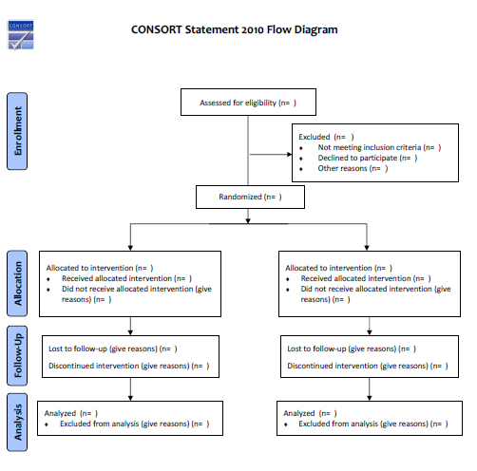

Slide 34
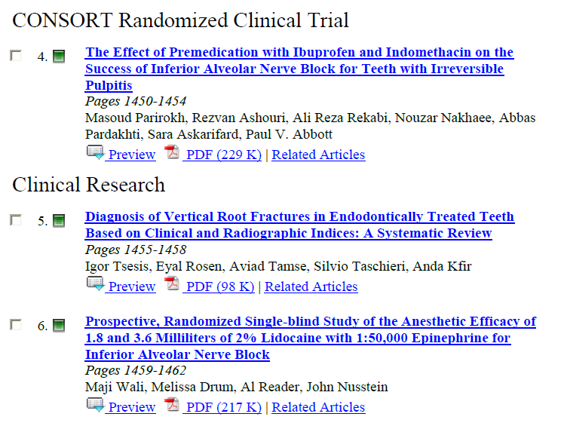
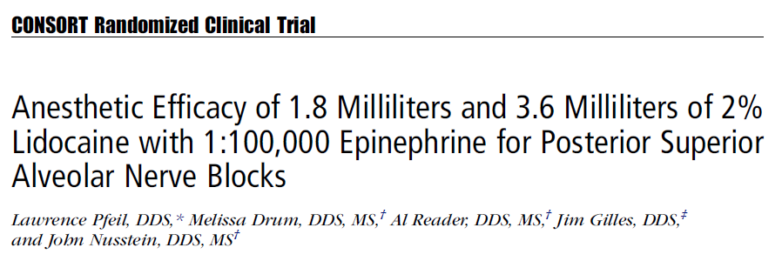

Slide 35
Top of the pyramid. Filtered information: Systematic Reviews and Meta-Analyses
Meta- Analyses
http://www.galter.northwestern.edu/Guides-and-Tutorials/ebm-resources

Slide 36
What is a systemativ review?
Formulating a problem
Locating and selecting studies (according to a predefined procedure)
Critical appraisal of studies
Collecting data
Analyzing and presenting results (according to a predefined procedure)
Interpreting results
Improving and updating reviews
Cochrane Handbook: seven steps for preparing and maintaining a systematic review

Slide 37
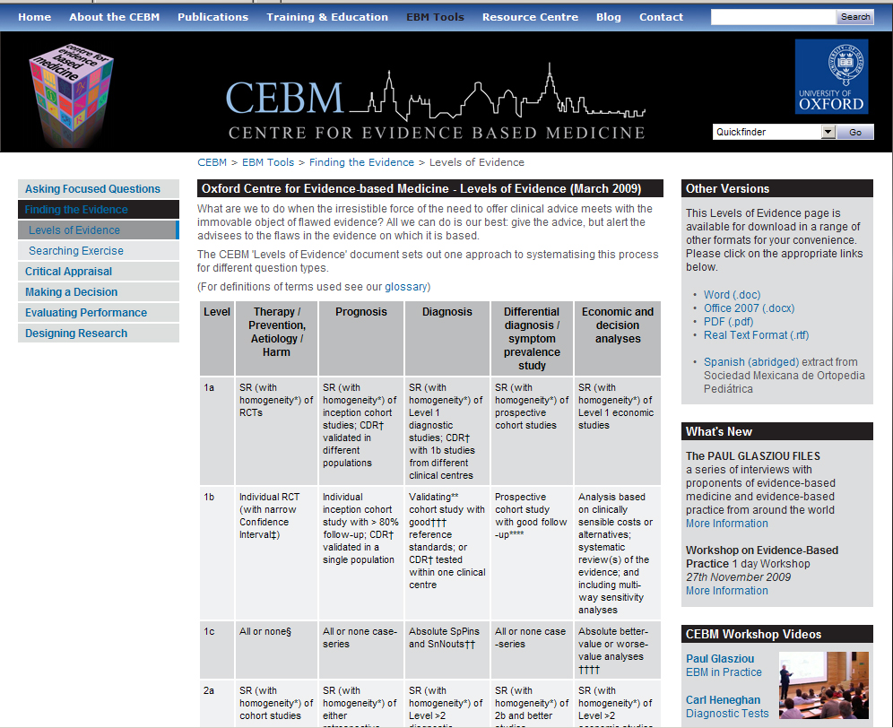

Slide 38
PubMed Search
”systematic review” endodontics
51 hits
14 selected of relevance to clinical, in vivo endo Tx
2 with attempts at meta-analyses
4 with attempts at comparing RCTs of similar design
None with RCTs with narrow conf intv or > 80 per cent follow-up

Slide 39
Cochrane Handbook: seven steps for preparing and maintaining a systematic review
Formulating a problem
Locating and selecting studies (predefined proc)
Critical appraisal of studies
Collecting data
Analyzing and presenting results (predefined proc)
Interpreting results
Improving and updating reviews
Critically different from the conventional review, and requires much more work in preparation.
The conventional review is at the discretion of the author with bias almost unavoidable
However, systematic reviews may be of limited help in the absence of high-quality clinical studies

Slide 40
Level | Therapy/Prevention, Aetiology/Harm
1a | Systematic Review (with homogeneity) of Randomized Clinical Trials
1b | Individual Randomized Clinical Trials (with narrow Confidence Interval)
1c | All or none
2a | Systematic Review (with homogeneity) of cohort studies
2b | Individual cohort study (including low quality RCT; e.g., <80% follow-up)
2c | "Outcomes" Research; Ecological studies
3a | Systematic Review (with homogeneity) of case-control studies
3b | Individual Case-Control Study (few cases, matching controls)
4 | Case-series (and poor quality cohort and case-control studies)
5 | Expert opinion without explicit critical appraisal, or based on physiology, bench research or "first principles" (logical deduction)
2008: "Systematic Review" endodontic: 13 references, 4 including RCTs
2010: "Systematic Review" endodontic: 51 references, 6 including RCTs
2008: 8 THROUGHOUT HISTORY – ALL WITH MINOR FLAWS
2005: 26 – MOSTLY FLAWED
2005: HUNDREDS
Torabinejad M, Kutsenko D, Machnick TK, Ismail A, Newton CW.Related Articles, Links Levels of evidence for the outcome of nonsurgical endodontic treatment. J Endod. 2005 Sep;31(9):637-46.

Slide 41
http://www.cochrane.org/
Vertical line:
no difference between treatments
Horisontal lines:
single trials with
95% margin
Red diamond:
Result of the Cochrane analysis

Slide 43
Structure of a Cochrane Review
Objectives - short statement of the aim of the review.
Selection criteria - brief description of the main elements of the question under consideration. This is subdivided into:
Types of studies - for example, randomized controlled trials. (Outside of Cochrane: it can also be done on laboratory studies of limited clinical interest.)
Types of participants - the population of interest. This section may include details of diagnostic criteria, if desired or appropriate.
Types of interventions - the main intervention under consideration and any comparison treatments.
Types of outcome measures - any outcome measures/endpoints (for example, reduction in symptoms) that are considered important by the reviewer, defined in advance; not only outcome measures actually used in trials.

Slide 44
Meta-analyses
www.prisma‐statement.org.
PRISMA (formerly QUOROM)
(Preferred Reporting Items for Systematic Reviews and Meta-Analyses)
Software: http://csl.georgetown.edu/software/
Raw data (combinable data) from different studies are collected systematically and reanalysed after separate, specific criteria
An explosion in all fields, including endodontology:

Slide 45
endodontic "meta analysis" "systematic review"
Results: 1 to 14
1. Frequency of nonodontogenic pain after endodontic therapy: a systematic review and meta-analysis. Nixdorf DR, Moana-Filho EJ, Law AS, McGuire LA, Hodges JS, John MT. J Endod. 2010 Sep;36(9):1494-8.
……..…….
………………

Slide 46
Themes studied
Non-odontogenic pain after treatment
Retained instruments and prognosis
Tooth survival after nonsurgical treatment
Persistent pain after treatment
Outcome after surgery vs retreatment
Single vs multiple appointments and outcome
Endo or implant outcome
Postop pain and flare-ups after multiple- vs single-visit therapy
Outcome after primary RCT
Antibacterial efficacy of Ca(OH)2
Level of evidence for outcome of non-surgical treatment
Outcome of single- vs multiple-visit endo on teeth with apical perio
Emergency management
Outcome of resurgery

Slide 47
Impact of a retained instrument on treatment outcome: a systematic review and meta-analysis. Panitvisai P, Parunnit P, Sathorn C, Messer HH. J Endod. 2010 May;36(5):775-80

Slide 48
Impact of a retained instrument on treatment outcome: a systematic review and meta-analysis. Panitvisai P, Parunnit P, Sathorn C, Messer HH.
INTRODUCTION: Fracture of root canal instruments is one of the most troublesome incidents in endodontic therapy. This systematic review and meta-analysis aim to determine the outcome difference between retained fractured instrument cases and matched conventional treated cases.

Slide 49
Impact of a retained instrument on treatment outcome: a systematic review and meta-analysis. Panitvisai P, Parunnit P, Sathorn C, Messer HH.
METHODS: The MEDLINE database, EMBASE, Web of Science, and the Cochrane Database were searched. Reference lists were scanned. A forward search was undertaken on identified articles. Papers citing these articles were identified through Science Citation Index to identify potentially relevant subsequent primary research. A systematic data extraction sheet was constructed. Data in these studies were independently extracted. Risk differences of included studies were combined by using the generic inverse variance data and fixed effects method. A 2-stage analysis was conducted. The first was limited to case-control studies, and the second included case series in which data were available for teeth with and without periradicular lesions.

Slide 50
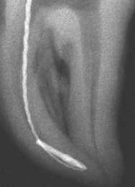
Impact of a retained instrument on treatment outcome: a systematic review and meta-analysis. Panitvisai P, Parunnit P, Sathorn C, Messer HH.
RESULTS: Two case-control studies were identified and included, covering 199 cases. Weighted mean healing for teeth with a retained instrument fragment was 91%. The 2 studies were homogeneous. Risk difference of the combined data was 0.01, indicating that a retained fragment did not significantly influence healing. Overall, 80.7% of lesions healed when a periapical lesion was present, compared with 92.4% remaining healthy when no lesion was present initially (P < .02).

Slide 51
Impact of a retained instrument on treatment outcome: a systematic review and meta-analysis. Panitvisai P, Parunnit P, Sathorn C, Messer HH.
CONCLUSIONS: On the basis of the current best available evidence, the prognosis for endodontic treatment when a fractured instrument fragment is left within a root canal is not significantly reduced.

Slide 52
What has NOT been assessed in clinical studies to the level of systematic reviews or meta-analyses?
Practically all diagnostic procedures
(Relative) effects of irrigants
Comparisons of methods and techniques for instrumentation
Most comparisons of methods, techniques and materials for root filling

Slide 53
Diagnostic Procedures
Pulpal diagnosis
Periapical diagnosis
Supportive examinations
Resorptions
Trauma
Non-infectious processes
Painful conditions
Tumors
Differential diagnostics
Perio
Tmd
Endo-perio lesions

Slide 54
Pulpal diagnosis
Histological
Hard tisue production
Vascular reactions
Inflammation
Diagnoses
Degeneration
Acute pulpitis
Chronic pulpitis
Clinical: subjective
Color change
Induced and spontaneous pain
Clinical: objective
(Color change)
Caries, inspected and excavated
Trauma damage
X-ray changes

Slide 55
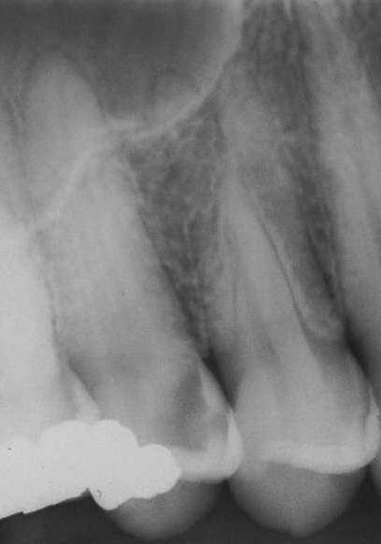
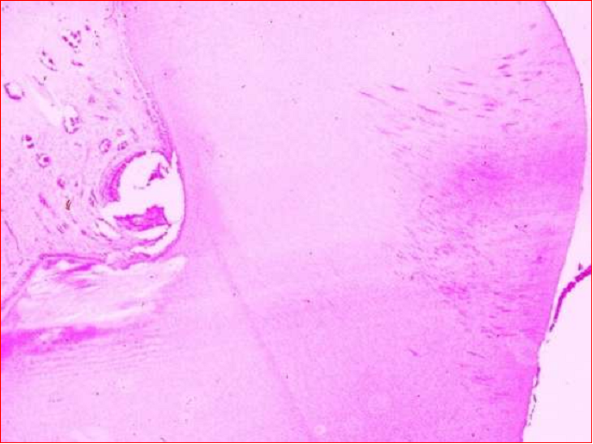
Vital, inflamed:
reversible-irreversible
Even microabscesses in the pulp may heal Mjør & Tronstad 1972

Slide 56
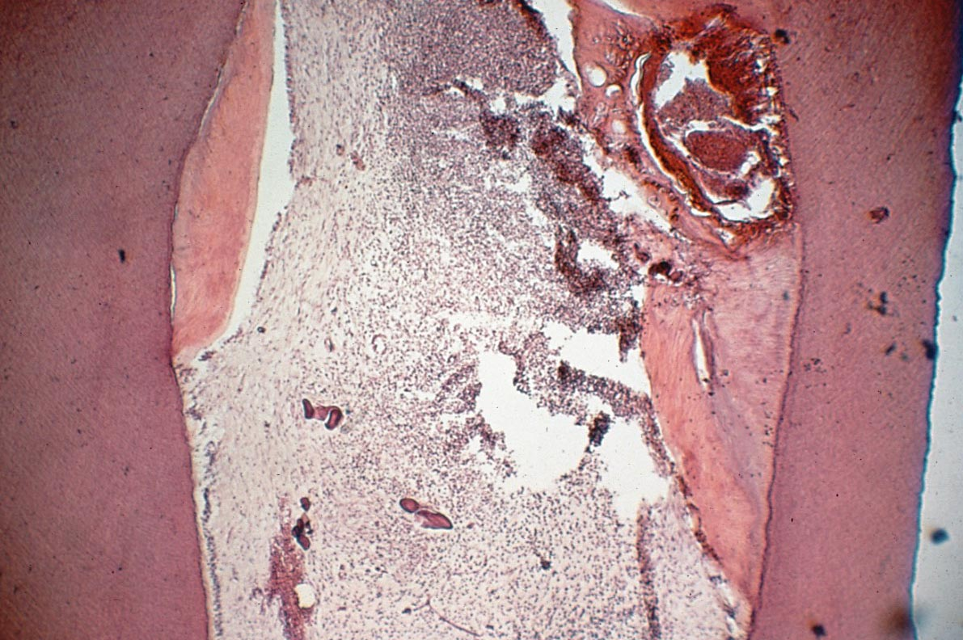
Pulpal diagnosis
Histological
Hard tisue production
Vascular reactions
Inflammation
Is it of interest?
Relationship to
Pain
Infection
(obliteration)
Clinical decision-making:
Where are the bacteria

Slide 57
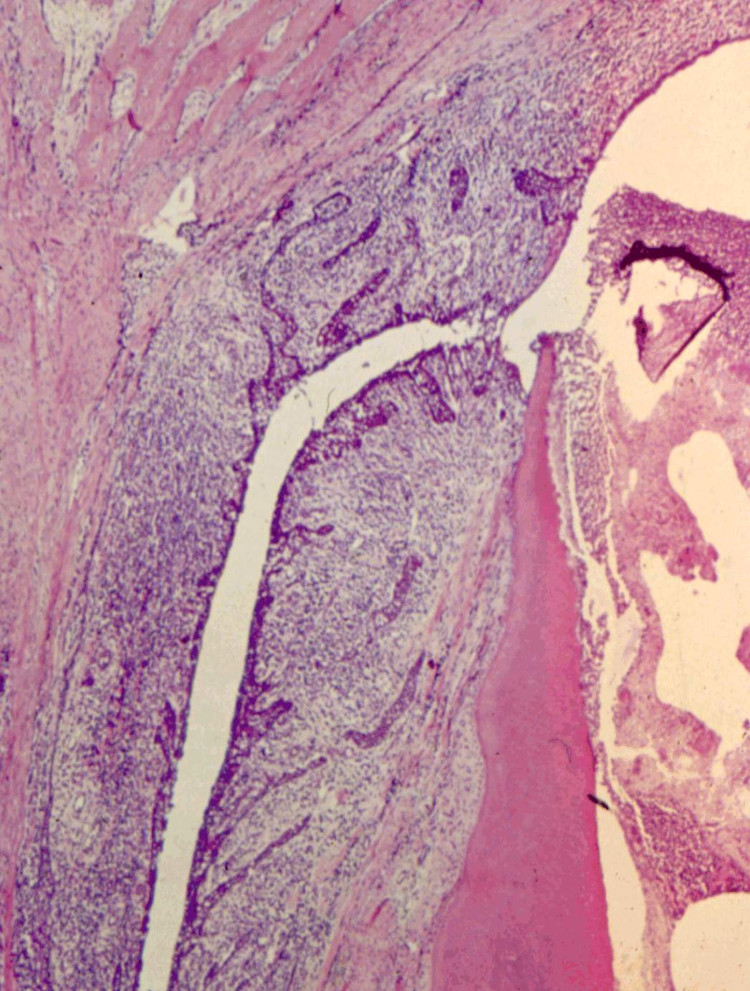
The Endo-Perio Issue
Histological
Periodontal breakdown without plaque downgrowth
Bacteria in pulp canal system maintaining periodontal infection
Is pretreatment diagnosis possible?
Alveolar bone
Sinus tract
Infected pulp canal
Valderhaug 1972

Slide 58
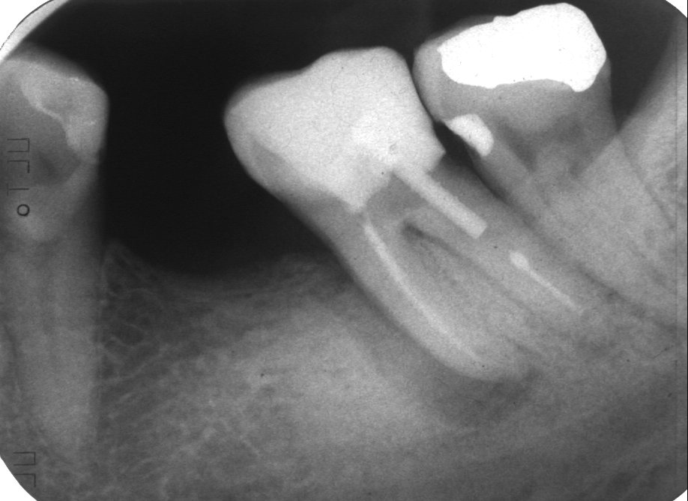
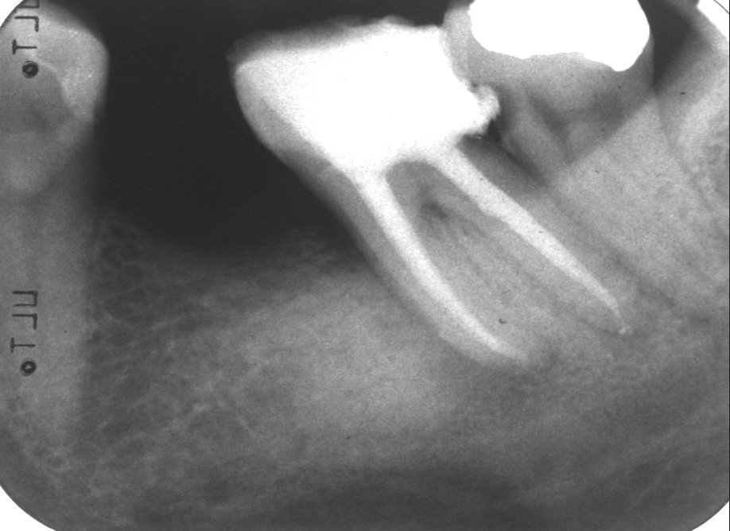

Slide 59
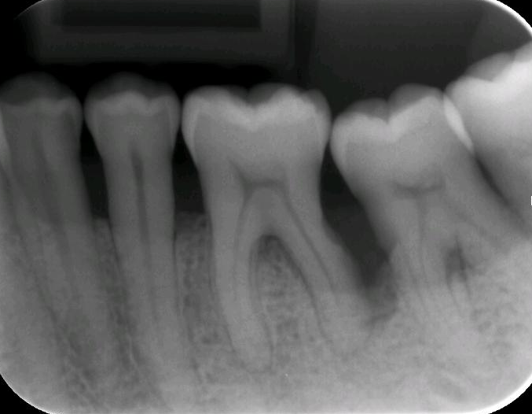

Slide 60
Endo-Perio Diagnosis
Evidence-based diagnosis is hardly possible preoperatively. Only when endodontic treatment leads to clinical success without periodontal intervention, can the diagnosis be confirmed.

Slide 61
Treatment Procedures
Capping
Direct and indirect
Pulpotomy
Pulpectomy
Disinfection (treatment of the necrotic pulp)
Surgical endodontics
Details
Surface disinfection
Irrigation
Dressing (one-step)
Root filling material
Coronal leakage and restoration
Implant alternative?
Usage of root-filled teeth

Slide 62
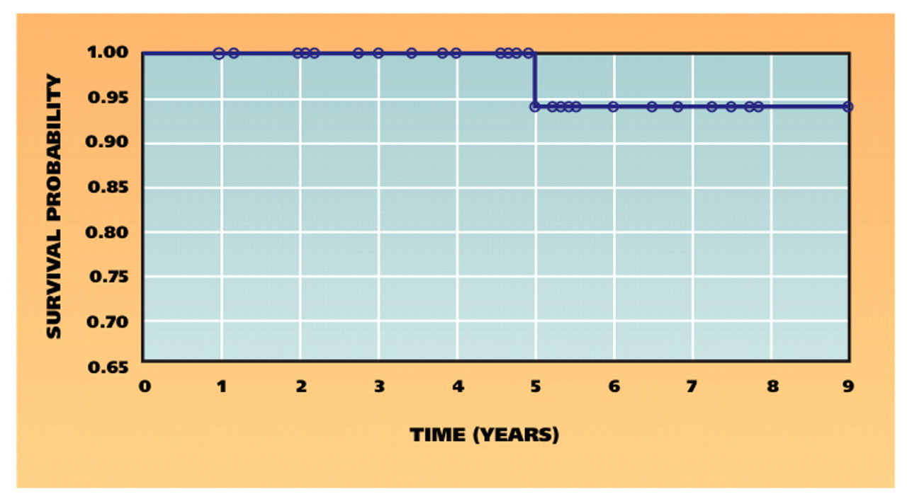
Direct pulp capping with mineral trioxide aggregate: an observational study.
Bogen G, Kim JS, Bakland LK.
J Am Dent Assoc. 2008 Mar;139(3):305-15

Slide 63
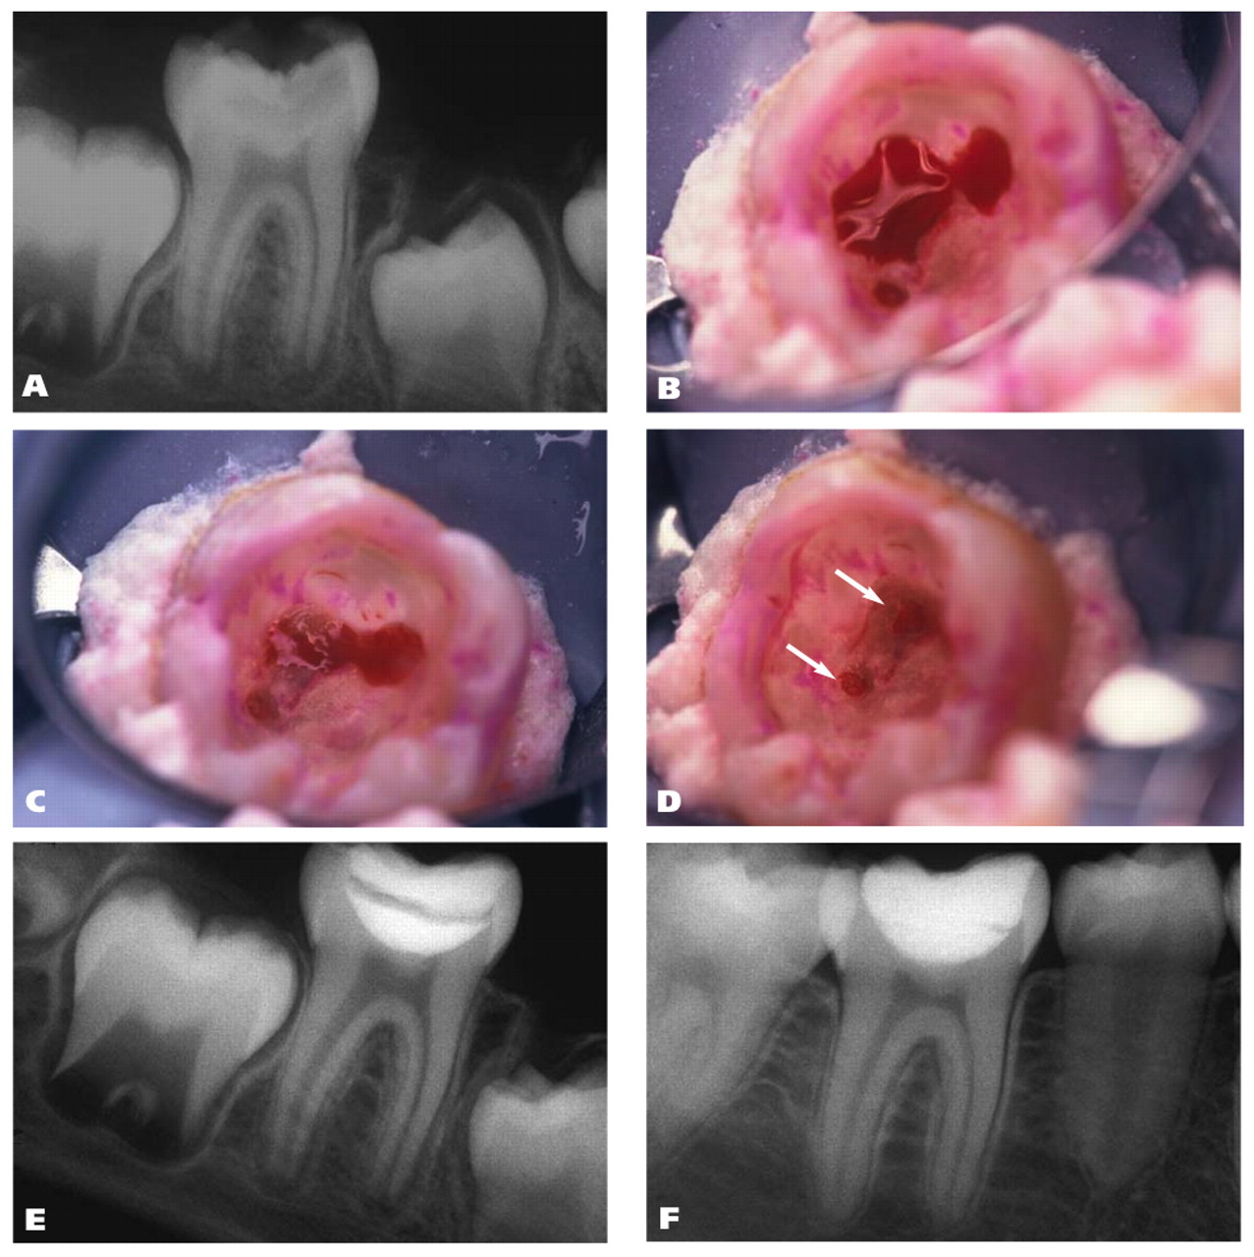
Direct pulp capping with mineral trioxide aggregate: an observational study.
Bogen G, Kim JS, Bakland LK.
J Am Dent Assoc. 2008 Mar;139(3):305-15
95% success!!!

Slide 64
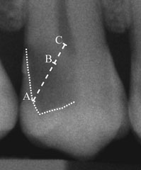
Treatment of deep caries lesions in adults: randomized clinical trials comparing stepwise vs. direct complete excavation, and direct pulp capping vs. partial pulpotomy.
Bjørndal L, Reit C, Bruun G, Markvart M, Kjaeldgaard M, Näsman P, Thordrup M, Dige I, Nyvad B, Fransson H, Lager A, Ericson D, Petersson K, Olsson J, Santimano EM, Wennström A, Winkel P, Gluud C.
Eur J Oral Sci. 2010 Jun;118(3):290-7

Slide 65
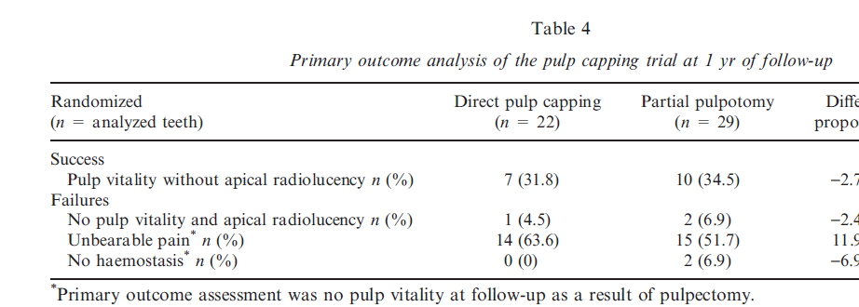
Dycal
Treatment of deep caries lesions in adults: randomized clinical trials comparing stepwise vs. direct complete excavation, and direct pulp capping vs. partial pulpotomy.
Bjørndal L, Reit C, Bruun G, Markvart M, Kjaeldgaard M, Näsman P, Thordrup M, Dige I, Nyvad B, Fransson H, Lager A, Ericson D, Petersson K, Olsson J, Santimano EM, Wennström A, Winkel P, Gluud C.
Eur J Oral Sci. 2010 Jun;118(3):290-7

Slide 66
Questions unanswered
Is MTA better than Dycal??
Is prognosis 95 % or 32 %??
How can we decide?
Multiple clinicians
Randomized allocation of capping material
Are alternative methods (pulpectomy) preferable?

Slide 67
Pulpectomy
What do we need to defend this procedure?
ALL institutional studies indicate that success rates, in terms of preventing apical periodontitis, are in the range of 93-98 per cent
Why do we look for improvement?
Perhaps there is histological signs of disease?
Animal studies: not likely, even with toxic materials
5% failure is still 1 in 20.
However, probably a result of diagnostic or procedural errors, not inherent in the procedures
Ridell et al 2008: Probably poor prognosis in adolescents

Slide 68
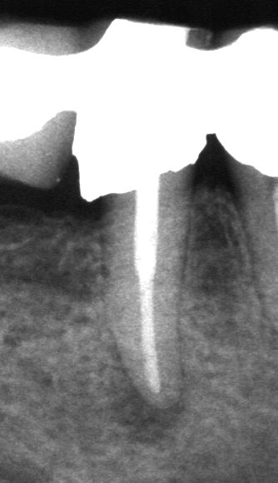
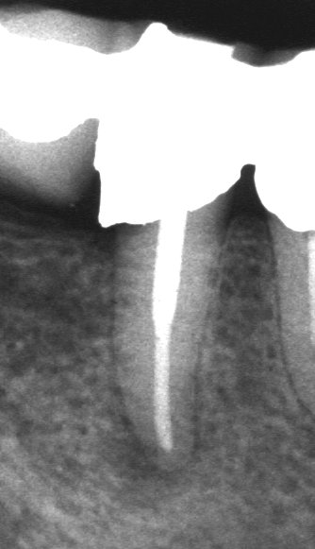
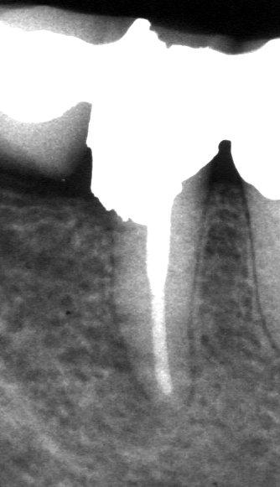
Challenge: apical periodontitis
At filling
3 months
12 months

Slide 69
Success rates for apical periodontitis
Strindberg 1956 88
Kerekes & Tronstad 1979 91
Ørstavik et al 1986 (2004) 79
Sjögren et al 1990 86
Marquis et al 2006 80
Zmener & Pamejer 2004 89
Field studies: Allways lower than 67%, probably much lower. The treatment of AP is what should guide the development of new methods, medicaments and materials.

Slide 70
New methods and materials
Irrigants: what do we want to know?
No consensus, no large-scale comparisons
Dressings: are they necessary
Commercially interesting, extensively studied
Instruments and machines
Commercially interesting; therefore, the main issue is evaded
Root filling materials
We have looked at that in the previous lecture

Slide 71
Irrigants: what do we want to know?
Is debris removal important? In vitro
Is smear removal important? In vitro
Is access to tubules important? In vitro
Is penetration important? In vitro
Is soft tissue removal important? In vitro
Is bacterial killing important? In vivo
Debris removal
Smear removal
Clearing of tubules
Penetrating to surface?
Removing soft tissue in apical delta and accessory canals
Killing of microbes
Tested via surrogate endpoints

Slide 72
Irrigants: what do we want to know?
 | EDTA | NaOCl | CHX | H2O2 | MTAD
Debris - in vitro | ± | + | ± | + | ±
Smear - in vitro | + | ± | - | ± | +
Tubule access - in vitro | ± | ± | + | ? | +
Soft tissue removal - in vitro | - | + | - | ± | -
Antimicrobial - in vivo | ± | + | ++ | + | ++
Substantivity - in vivo | - | - | + | - | +
What we want, is a consensus on which ”surrogate endpoint” we should accept.
Personally, I would accept only the microbiological effect. Until we agree, research can continue indefinitively with any one product showing superior performance in the test selected

Slide 73
Dressings
Which one is better?
No high-level, clinical study has ever challenged calcium hydroxide
The original data were based on low quality cohort and case series studies
Small attempts are made to compare Ca(OH)2 with CHX preparations
Do we need one?
Several RCTs have been carried out
There is ample evidence to support the contention that a Ca(OH)2-dressing does not provide a necessary, additonal antibacterial regimen.
But can we improve the dressing?

Slide 74
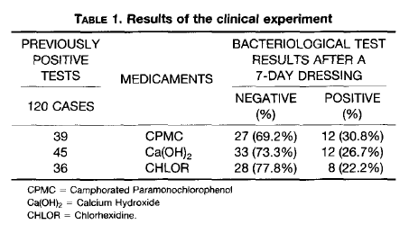
Evaluation of the antibacterial activities of calcium hydroxide, chlorhexidine, and camphorated paramonochlorophenol as intracanal medicament. A clinical and laboratory study Barbosa et al., 1997, JOE
The ”momentum” of calcium hydroxide in decades past

Slide 75
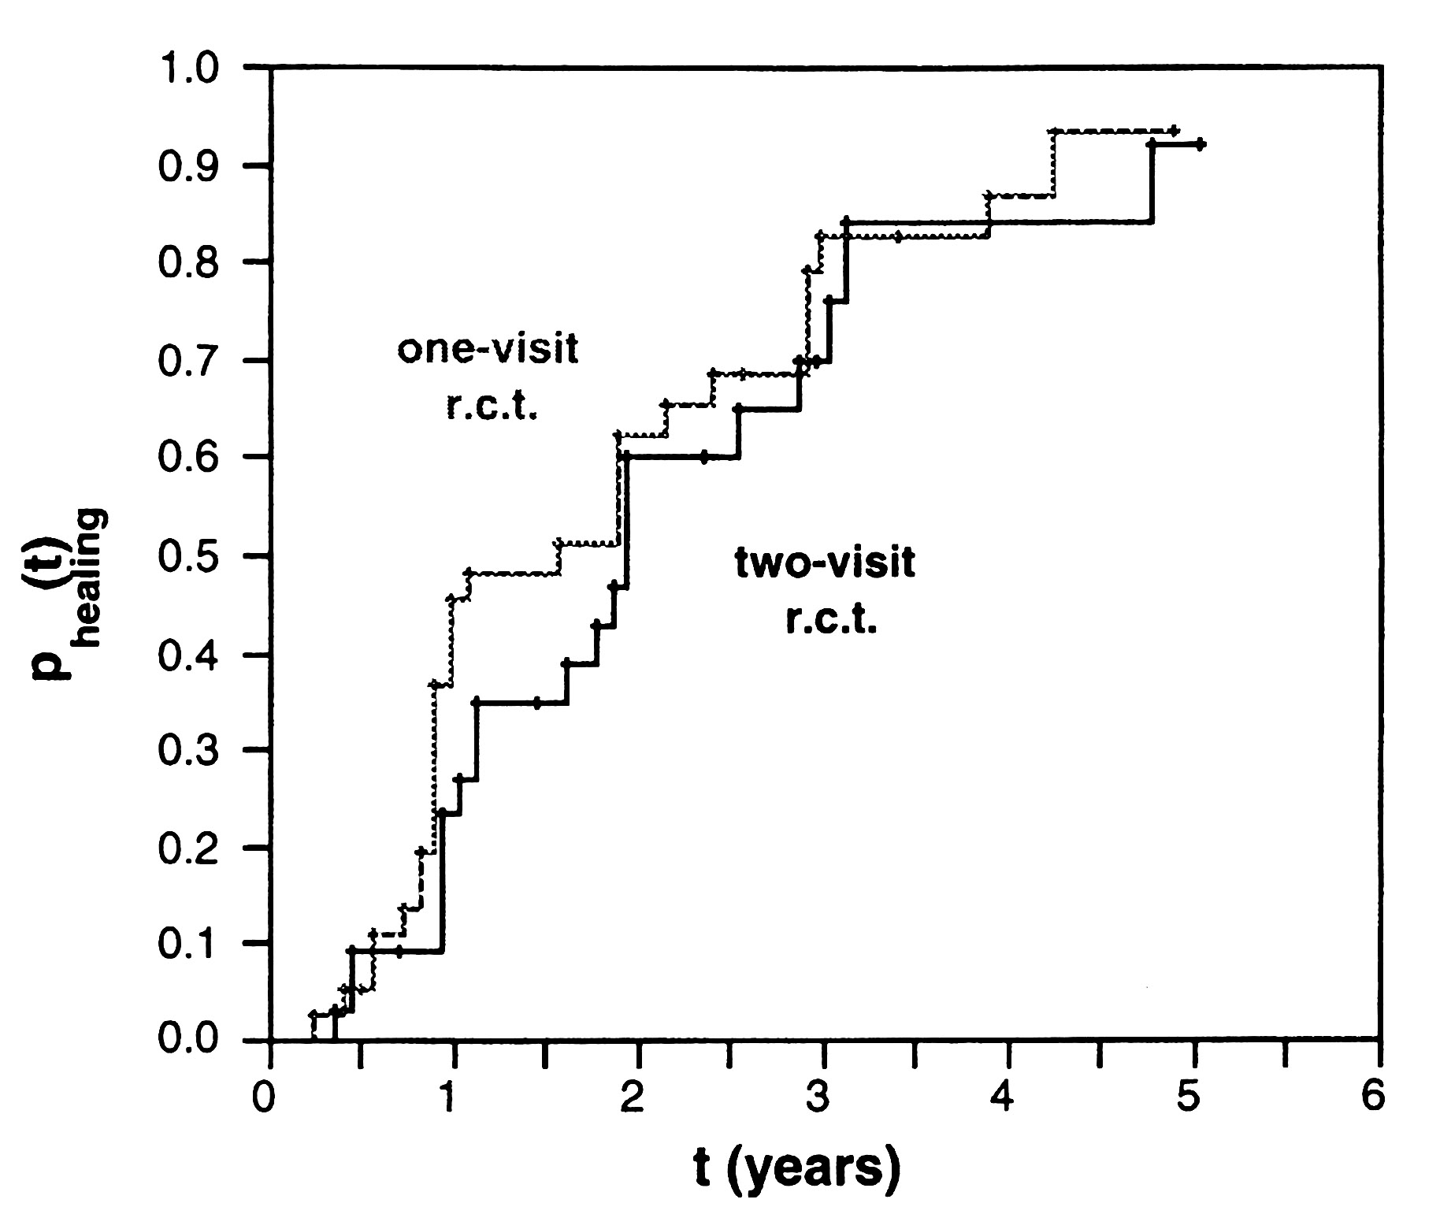
Weiger et al.,
Calcium hydroxide and prognosis of RCT.
IEJ 2000; 33:219-226
The bottom line from many sources maintains a success rate in the range of 40-80 per cent

Slide 76
Instruments and machines
They are the greatest inventions of our specialty, yet they do not warrant extensive clinical study
Is there a clinical benefit?
Probably only indirectly in that more teeth may be treated successfully, and even that is difficult to assess.
One study, no measurable benefit (note extremely high success rate for baseline)

Slide 77
Comparison of classic endodontic techniques versus contemporary techniques on endodontic treatment success. Fleming et al. 2010, JOE
Characteristics of Failures | Classic Group (%) | Contemporary Group (%)
Failures | 9/459 | 21/525
Percentage | 1.96% | 4.00%
Anteriors | 1 (11.1) | 0 (0.0)
Premolars | 1 (11.1) | 13 (61.9)
Molars | 7 (77.8) | 8 (38.1)
Overfills/flush fills | 0 (0.0) | 9 (42.9)
Post present | 0 (0.0) | 8 (38.1)
Preoperative area | 4 (44.4) | 10 (47.6)
Post Tx intervention | 1 (11.1) | 0 (0.0)

Slide 78
Improved quality of root fillings provided by general dental practitioners educated in nickel-titanium rotary instrumentation. Molander A, Caplan D, Bergenholtz G, Reit C. Int Endod J. 2007 Apr;40(4):254-60.

Slide 79
Improved quality of root fillings provided by general dental practitioners educated in nickel-titanium rotary instrumentation. Molander A, Caplan D, Bergenholtz G, Reit C. Int Endod J. 2007 Apr;40(4):254-60.
Score 1: Correct length, adequate seal, tapered preparation, no transport.
Score 2: Correct length, adequate seal, lack of taper and/or transport.
Score 3: Incorrect length, adequate seal, (taper and transport not evaluated).
Score 4: Correct length, defective seal, (taper and transport not evaluated).
Score 5: Incorrect length, defective seal, (taper and transport not evaluated).

Slide 80
Improved quality of root fillings provided by general dental practitioners educated in nickel-titanium rotary instrumentation. Molander A, Caplan D, Bergenholtz G, Reit C. Int Endod J. 2007 Apr;40(4):254-60.
Table 1. Ratios for quality scores 1 and 5 for each experimental group at baseline and post-intervention
Group | Baseline quality score 1/5 ratio | Post-intervention quality score 1/5 ratio
L | 32/22 = 1.45 | 51/16 = 3.19
LH | 19/9 = 2.11 | 32/6 = 5.33
C | 52/28 = 1.86 | 58/32 = 1.81
CL | 13/15 = 0.87 | 30/10 = 3.0
CLH | 45/14 = 3.21 | 36/4 = 9.0
“In conclusion, data from the present study supported the proposed hypothesis that if NTRI technology replaces the manual stainless steel technique the rate of good quality root fillings will increase. A significant drop in the rate of low quality root fillings was not found.”

Slide 81
Science Base
The classical pyramid of evidence
High-Level Evidence
Systematic Clinical Experiments
RCTs: one-step, materials
Cohort: materials & medicaments, some diagnostics
Case-Control: systemic diseases
Case-Series: a lot for any procedure
Low-Level Evidence
Animal and Lab Studies, Biological Plausibility, Expert Opinion
From Lesaffre et al 2009

Slide 82
Conclusions
High-level, comparative evidence is lacking for practically all procedures in endodontic treatment
Commercial products claiming superiority should show randomised test comparisons with standard materials/medicaments
The very high success rates of most dental and endodontic procedures makes testing complicated, but also less pressing
High-level testing should be planned for products that realistically may improve results

